Slide 1
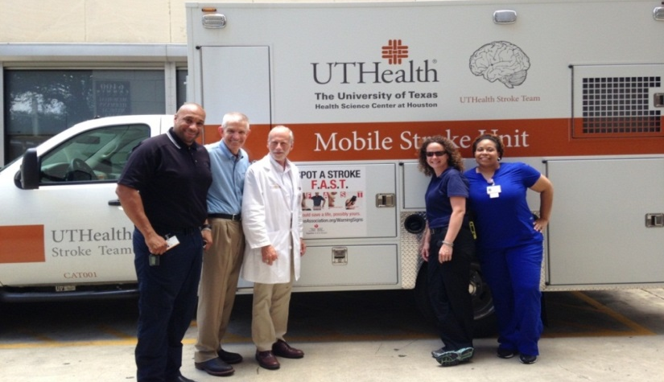
Mobile Stroke Units—why, how, and worth it
James C. Grotta MD
Director, Mobile Stroke Unit Consortium
Clinical Innovation and Research Institute
Memorial Hermann Hospital-TMC
Houston, Texas

Slide 2
Disclosures for Dr Grotta
Grants/Research Support: AHA, Genentech (tPA for MSU), PCORI
Consulting Fees: Frazer Ltd
I am blinded to study group outcome study data
Notes:
Presenters and Faculty: Add in your name and declare any conflicts of interest
PRESENTERS: Please complete this slide based on your actual presentation. If you are doing more than one presentation, you need to submit a set of these three slides for EACH presentation

Slide 3


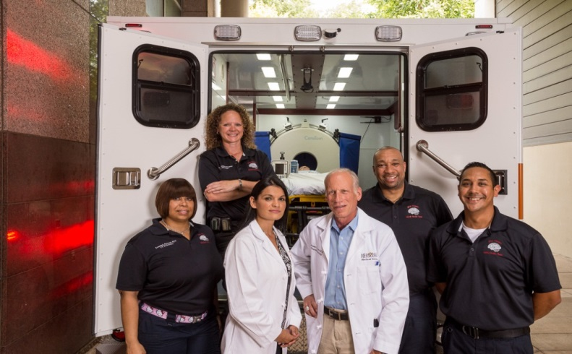
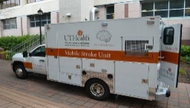
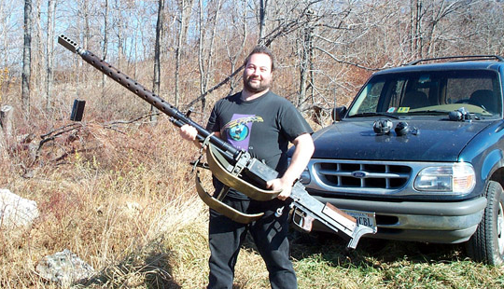
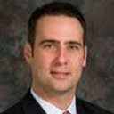
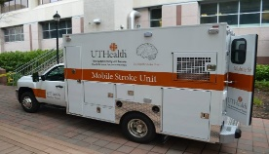
tPA vs Thrombectomy
tPA
  Fastest gun in the wild west; everyone has one
  But can’t bring down big game
  Challenge:
    Speeding tPA treatment
Thrombectomy
  Big bubba with the big gun
  Important advance for severe strokes
  Challenge:
    How to quickly triage

Slide 4
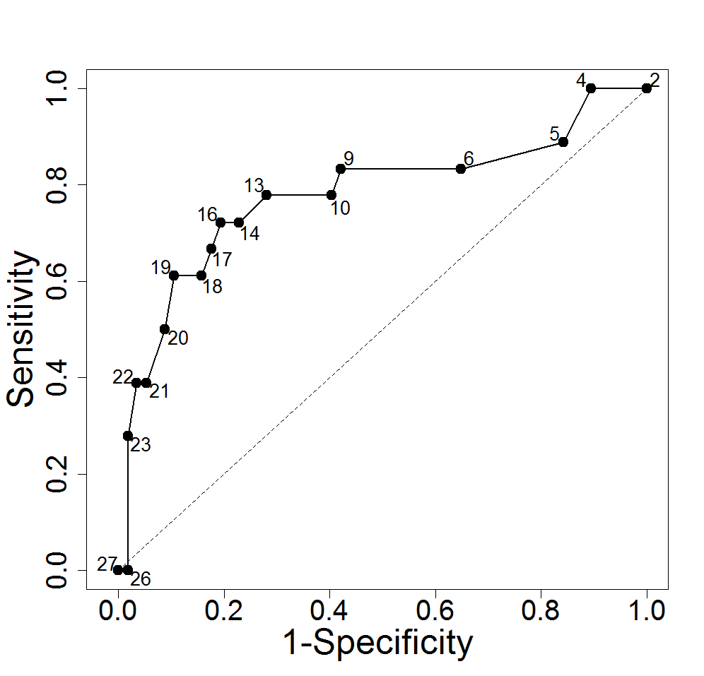
tPA will remain the most frequent treatment
NIHSS scores in overall population who are candidates for tPA and for IAT
Reeves M, Kleindorfer D et al, abstract ISC 2012

Slide 5
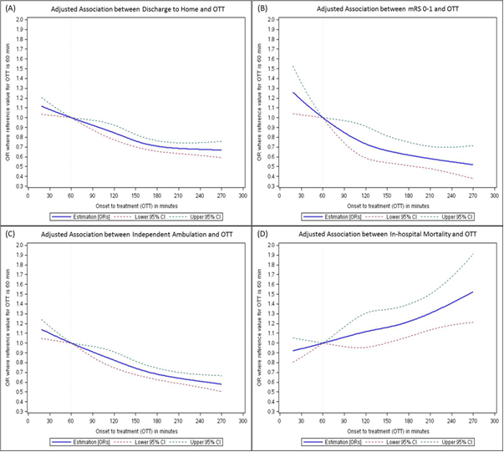
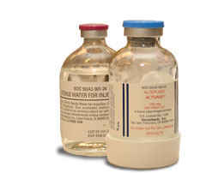
Kim et al,11/4/16
Yes we can treat out to 24 hours, but earlier access means----
More patients with favorable imaging
Exponential benefit in the first hour for tPA and two hours for thrombectomy

Slide 6
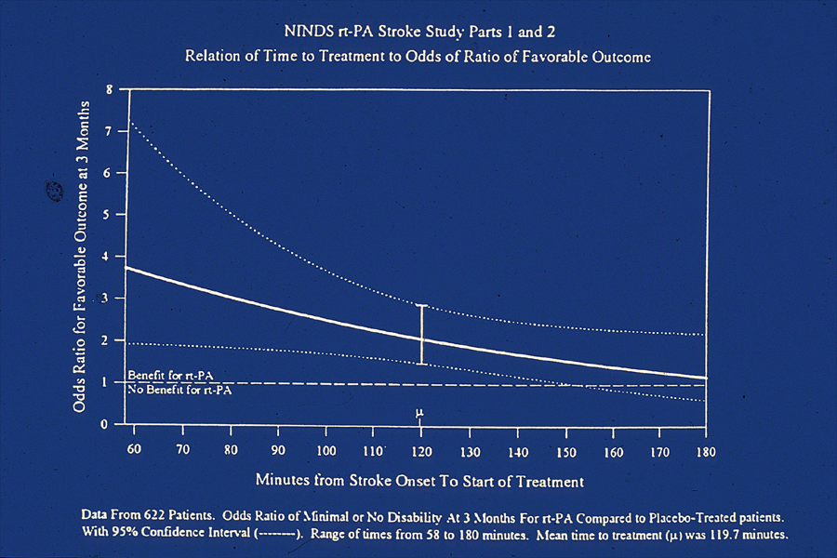

MSUs are the only way to bring stroke treatment into the first hour where it may have an exponential benefit

Slide 7

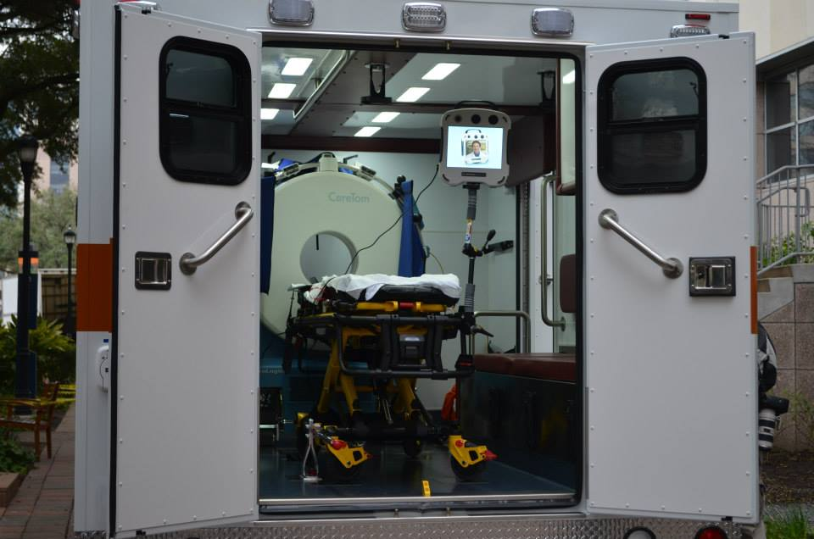
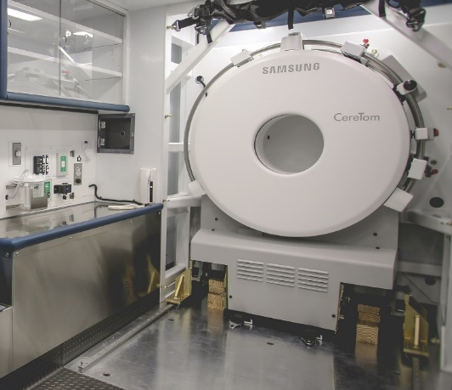
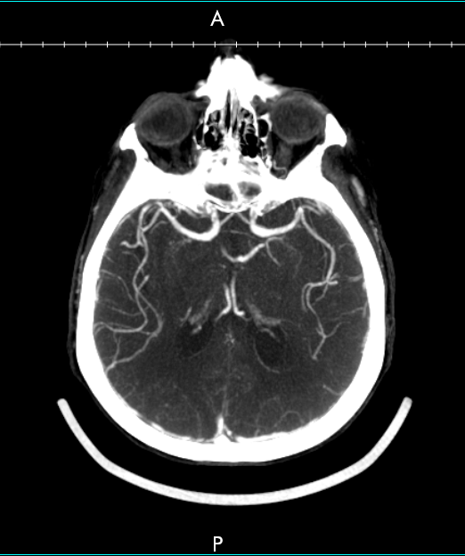
Mobile Stroke Units Don’t Need to be Fancy
Standard 12 foot ambulance
Portable CT scanner
Point-of-care laboratory
Tele-radiology & neurology
VN, RN, CT tech, Medic

Slide 8
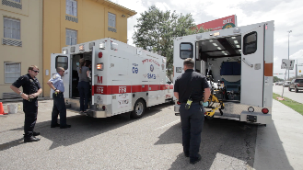
MSU Dispatch Process
911 call
EMS ambulance immediately dispatched per routine
MSU team dispatched to site
MSU team meets EMS ambulance at emergency site

Slide 9
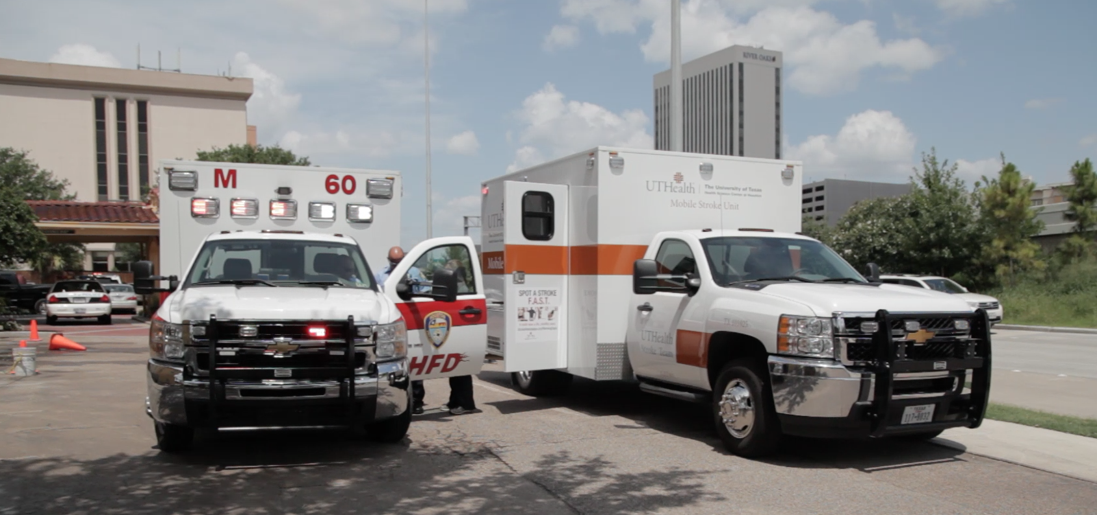
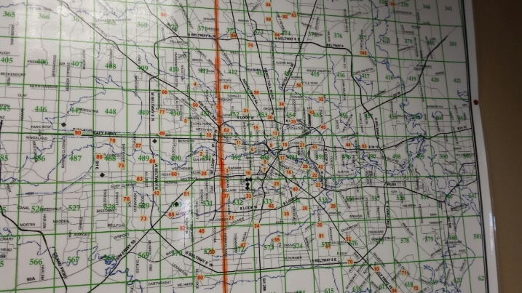
MSUs are Practical
2016 to 2018: 290 acute ischemic stroke patients treated with tPA on our MSU
140 (48.3%) treated on scene by direct 911 dispatch
median 7 miles from MSU base
150 (51.7%) patients treated by rendezvous
their strokes occurred median 13 miles from base (p<0.0001)
Time (min) from 911 alert to tPA bolus
37 ± 10 with on-scene
38 ± 13 with rendezvous (p=0.89).
26 mi

Slide 10

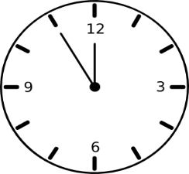
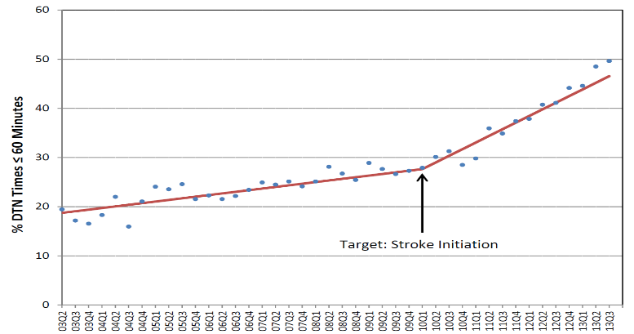
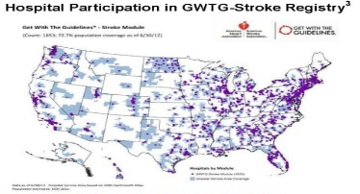
MSU on scene time < EMS transport time
HFD average on scene 15 minutes
HFD transport time to a CSC 5- 30 minutes
Mobile Stroke Unit avg time on scene to tPA 25 minutes
20-45 min HFD arrive on scene
to ED
and then
We save the entire ED door to needle time
DTN
60 min

Slide 11
BEST-MSU Study
Benefits of Stroke Treatment Delivered Using a Mobile Stroke Unit Compared to Standard Management by Emergency Medical Services
Patient Centered Outcomes Research Institute (PCORI)
$5M over 5 years
“If I have a stroke and call 911, am I better off if treated in a MSU vs EMS?”
SPECIFIC AIMS
How much less disability at 3 months?
    - Utility weighted mRS
Healthcare Utilization, Costs, QOL
- Pts followed up to 1 yr

Slide 12

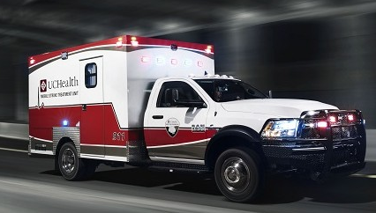
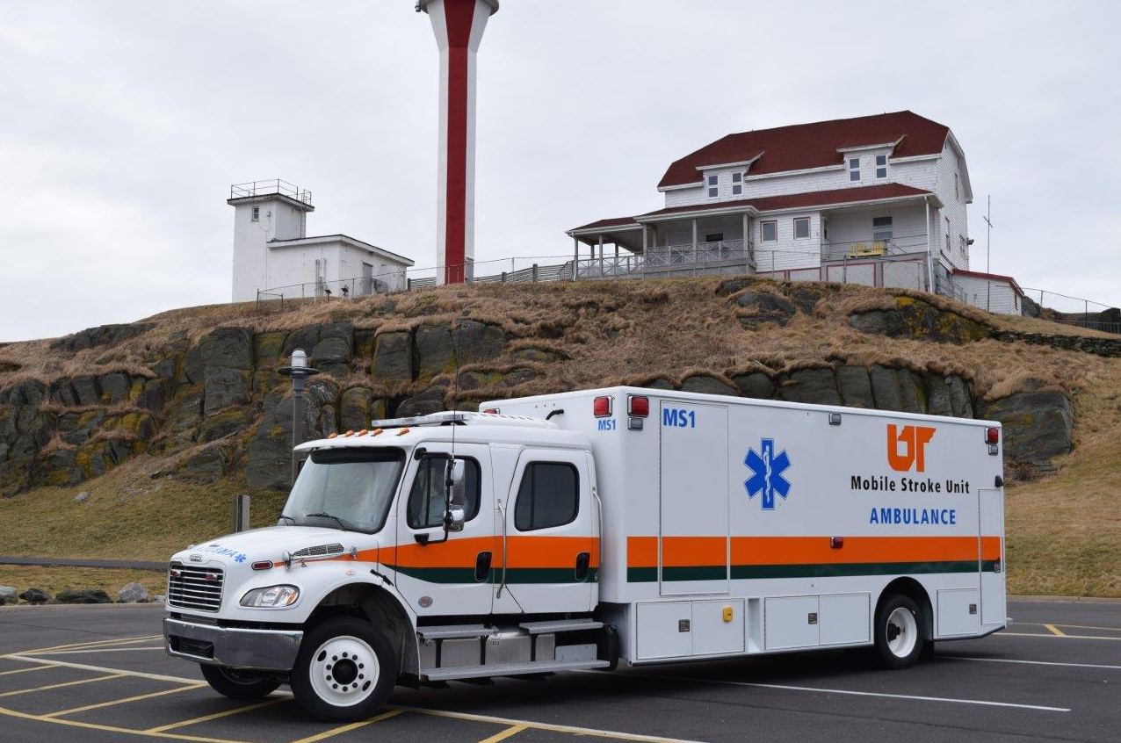
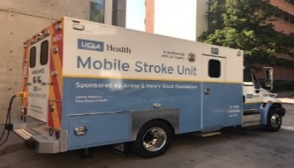
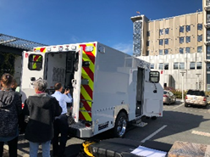
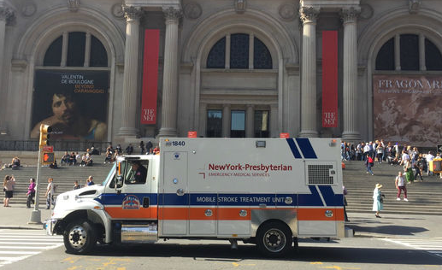
Colorado (Aurora and Colo Spgs)
Memphis
LA-UCLA
Sutter-Peninsula
Late 2018
New York

Slide 13
Symptom Onset to tPA Bolus
MSU AND SM GROUPS COMBINED

Slide 14
Symptom Onset to Groin Puncture
MSU AND SM GROUPS COMBINED

Slide 15
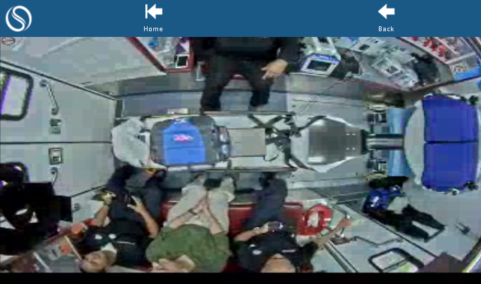
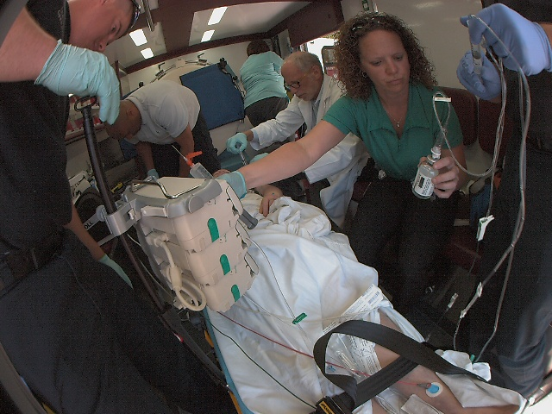
The on board MD can be replaced by a TM MD
Satisfactory connectivity (98%)
Agreement between On-Board and TM VN
  88% (compared with in-person in ED)
TM consult is just as fast

Slide 16
In Conclusion
Very effective stroke treatments are available
Speeding these treatments will
  Increase the number treated
  Improve outcomes
Pre-hospital treatment on MSUs is the best way to make a major increment in speeding treatment

Slide 17
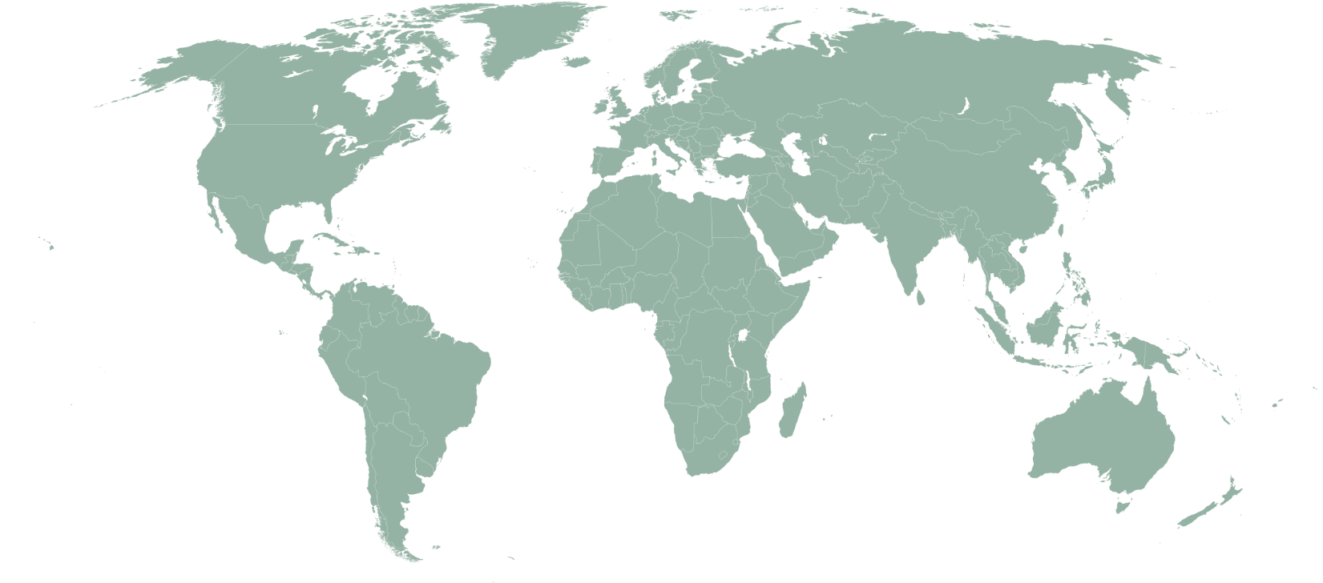
PRESTO—PRE-hospital Stroke Treatment Organization
Columbus (OH, USA)
Rochester (NY, USA)
Toledo (OH, USA)
New York X 3 (NY, USA)
Chicago X 2 (IL, USA)
Leuven (Belgium)
Marburg (Germany)
Berlin X 3(Germany)
Cleveland (OH, USA)
Drobak (Norway)
Edmonton (Alberta, Canada)
Helsinki (Finland)
Southend (UK)
Denver (CO, USA)
TBN
Lille (France)
Trenton (NJ, USA)
Burlingame (CA, USA)
Allentown (PA, USA)
Columbus (OH, USA)
Zhengzhou (Henan, China)
Indianapolis (IN, USA)
Paris (France)
Doha (Qatar)
Los Angeles (CA, USA)
Homburg/Saar (Germany)
Coimbatore
(Tamil Nadu, India)
Phoenix (AZ, USA)
Aarau (Switzerland)
Bangkok (Thailand)
Houston (TX, USA)
Memphis (TN, USA)
Atlanta (Ga, USA)
Buenos Aires (Argentina)
Melbourne (Australia)
sites with active mobile stroke units
sites with projects in planning or implementation state
Lesmeister/Fassbender 2018

Slide 18

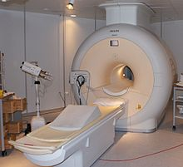
5 yr Cost/Effectiveness Analysis
Cost of CT Scanner $ 400,000
Ambulance /Chassis/ALS Equip $ 600,000
TM equipment $ 30,000
Other Stuff $ 70,000
Operating Costs X 5 yrs $ 500,000
Staff: Paramedic/EMT/Nurse and TM MD X 5 yrs (1 shift/d) $ 2,000,000
Total fixed and continuing costs for 1 MSTU X 5 yrs $ 3,600,000
$$
=
Lifetime direct cost per stroke (1999 dollars) $ 140,000 (Circulation. 2009;119:e21-e181)
Therefore, cost neutral if:
1 MSU results in 5 more patients/yr completely recovering

Slide 19
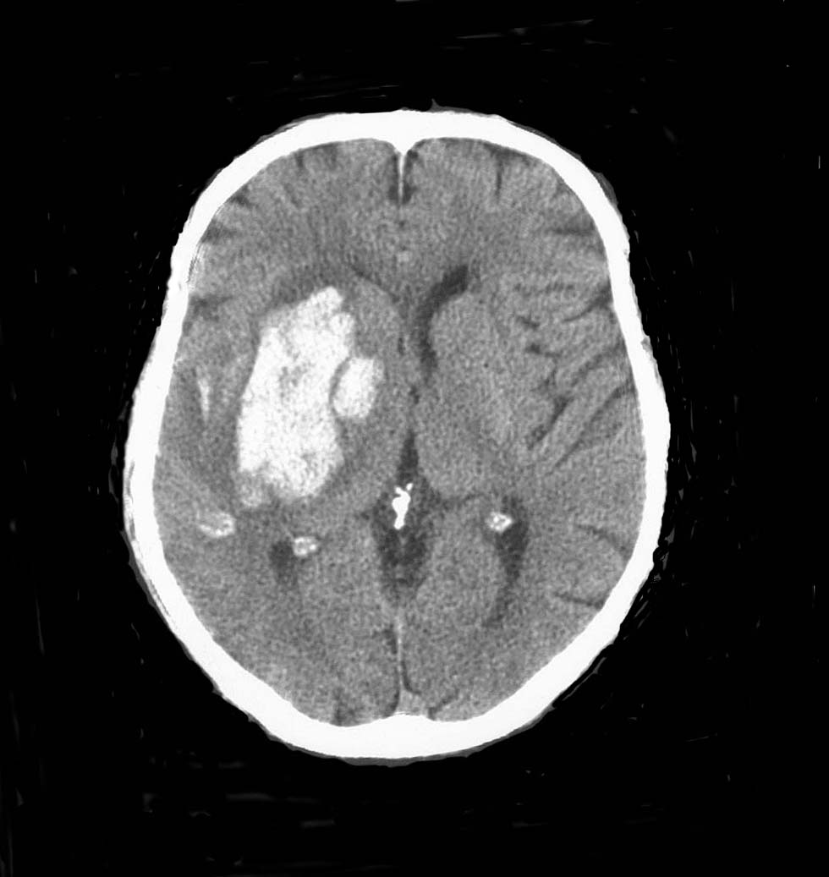
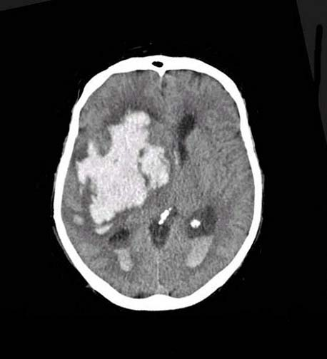
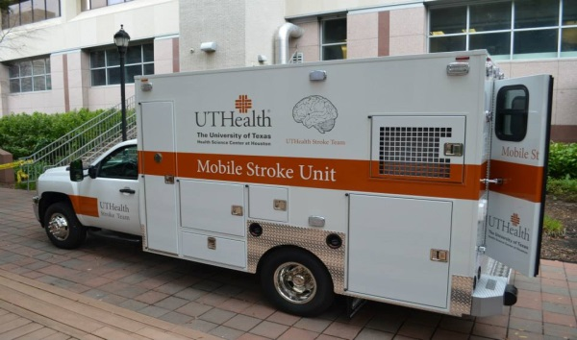
We will arrest early hematoma growth with quicker hemostatic therapy
1 hr

Slide 20
Current MSU Reimbursement
Ambulance transport codes set by CMS—depends on mileage
ALS-2 = 2 IV meds, CPR etc ~$480
Specialty care transport
(facility to facility, requires a critical care nurse and paramedic) ~$1280
Proposal: create ALS-3= IV meds, diagnostics, treatment I calculate we would need ~$1000
CT billing
Technical Fee $0
Professional Fee can be billed
Drugs including TPA
In-pt code $3000
Out-pt code (per mg + bolus administration fee) $3000+
But no code for ambulance or MSU treatment $0
Physician consultation currently 0; TM codes in 2019

Slide 21
Payment for transports
5 yr Pro Forma—CMS/Insurers—for Houston
Current Transports (2 shifts, 3 MSTUs = 10/d @ $500 ea) x 5 yrs $ 9,125,000
Increased reimbursement from $500 to @ $921 ea $ 16,808,250
Net increase payments over 5 years $ 7,683,250
Long term health costs
Current costs (10 pts/d @ $140,000 ea X 5 yrs) $ 2,520,000,000
Reverse just one stroke per month $ 2,511,600,000
Net reduction in payouts over 5 years $ 8,400,000
5 yr overall savings to CMS (Houston alone): $ 716,750

Slide 22
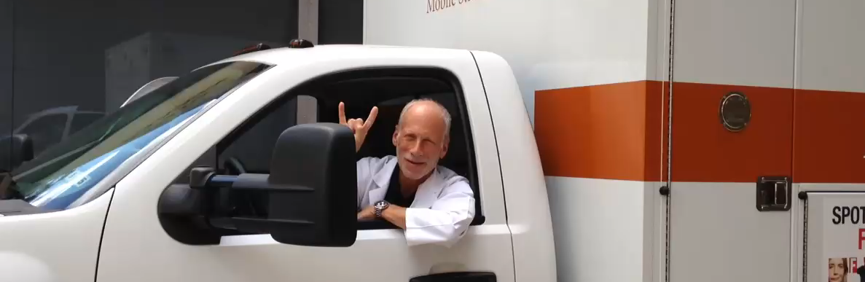
….MSUs
    Are proliferating whether you agree or not
    Are probably cost effective
    Require us to “think outside the box” of current practice

