Slide 1
13th Annual NECC Summit Thursday, October 25th New York State Breakout Session
Facilitated By:
David Ben-Eli, MD, FACEP, FAEMS
Division Medical Director, Office of Medical Affairs, Fire Department New York - New York, NY
Ethan Brandler, MD, MPH, FACEP
Associate Director of Emergency Medical Services, SUNY Stony Brook - Stony Brook, NY
Jeremy Cushman, MD, MS, EMT-P, FACEP, FAEMS
Vice Chair, NECC; Associate Professor & Chief, Division of Pre-Hospital Medicine,
University of Rochester - Rochester, NY
Michael Redlener, MD, FAEMS
Assistant Professor, Medical Director for EMS & Disaster Preparedness, Department of Emergency Medicine, Mount Sinai St. Luke’s & Mount Sinai West - New York, NY
Notes:
MR: Intro

Slide 2
Session Objectives
Improve awareness of NY Stroke System of Care Initiatives
Understand New York State Department of Health-Stroke Regulations
Notes:
MR: Intro

Slide 3
Disclosures
Dr. David Ben-Eli
None
Dr. Ethan Brandler
None
Dr. Jeremy Cushman
None
Dr. Michael Redlener
None
Dr. Jeanne Alicandro
None
Notes:
Each of you say a little something!

Slide 4
A Few Guiding Points
This is a statewide session, per many requests last year
Please keep regional questions to a minimum, we are here through tomorrow for offline discussion
Parking lot for topics/questions
Notes:
DBE-Guiding Principles

Slide 5
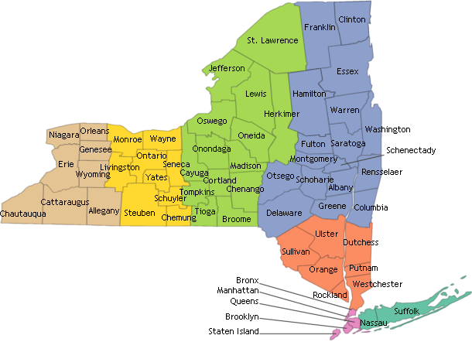
Audience Survey - Show of Hands…
Who is from:
Capital Region?
Central NY?
Hudson Valley?
Long Island?
New York City?
Westchester?
Western NY?
Notes:
DBE-Survey

Slide 6
Mission: Lifeline Stroke
Extension of GWTG
Collating data to help measure processes like:
-prenotification
-on-scene time
-Door to CT/Door to Needle
-Door in Door Out
Mission: Lifeline Stroke
FAST
Call 9-1-1
Primary Stroke Center Hospital
Inter-hospital transfer
Onset of Stroke symptoms
9-1-1 EMS dispatch
• EMS on-scene
• LKW Time • Stroke Screen • LVO Screening Tool
Stroke Alert Protocol
EMS Triage Plan
Thrombectomy Capable Center
Total Ischemic Time
6
* Using patient selection criteria consistent with 2018 AHA/ASA AIS Guidelines. https://doi.org/10.1161/STR.0000000000000158
Notes:
MR
This slide has animation
This slide walks us through how ML Stroke works.
We start when EMS picks up the patient (EMS First Medical Contact)
Depending on various factors a patient may be triaged to a PSS hospital or an endovascular capable center
Sometimes they need to be transferred
ML Stroke helps us measure field triage and inter-hospital transfers, as well as other processes, via data collected in GWTG-S

Slide 7
EMS Data MEASURES
GWTG Pre-Hospital Care Measures
New York State Pre-Hospital Stroke Measures
Documentation of Time Last Known Well or Time of Discovery of Stroke Symptoms
Evaluation of Blood Glucose
Stroke Screen Performed and Reported
Stroke Severity Screen Performed and Reported
On-Scene Times for Suspected Stroke
Times from First Medical Contact to Thrombectomy for Acute Ischemic Stroke
Advanced Notification with Triage Findings (Coverdell only)
Use of Thrombolytic Checklist (Coverdell only)
EMS Pre-Hospital Stroke Scale
Pre-Notification Content
Notes:
JC

Slide 8
Notes:
MR: There are many regional efforts on-going—this map shows the pre-hospital work. There is also a statewide interfacility group underway.

Slide 9
NYS Stroke Services Regulations
Section §405.34 will be added to Title 10 of the Official Compilation of Codes, Rules and Regulations of NYS
Ensure access to quality, evidence-based stroke care for all patients at the right time and in the right setting throughout NYS
Establish a framework to support regional operationalization of transport and quality processes for suspected stroke.
Maintain data reporting for stroke system evaluation and monitoring
Create a sustainable stroke designation program that can evolve as new evidence emerges.
Proposed regulations and details on how to submit a public comment can be found at the following link:
https://regs.health.ny.gov/regulations/proposed-rule-making

Slide 10
NYS Stroke Services Regulation Timeline
2018
Oct
Nov
Dec
2019
Feb
Mar
2019
Today
62 days
Regulation Public Comment Period
10/17/2018 - 12/17/2018
46 days
Assessment of Public Comment
12/17/2018 - 1/31/2019
1 day
PHHPC Presentation for Adoption of Regulation
2/14/2019
31 days
3/1/2019 - 3/31/2019
Regulation Adopted and Published
Disclaimer: This is an estimated time frame and may change.

Slide 11
Thank you!

Slide 12
Extra Slides

Slide 13
History of Prehospital-Specific Data Collection in NY State – cont.
Added December 2016
“EMS data elements” for GWTG
Arrival at scene by EMS responding agency = Date/Time, Date only, or Unknown
Scene departure = Date/Time, Date only, or Unknown
Blood Glucose level (mg/dL) = Too High, Too Low, or Glucometer Not Available
Date/Time patient last know to be well as documented by EMS = Date/Time, Date only, or Unknown
Date/Time of discovery of stroke symptoms as documented by EMS = Date/Time, Date only, or Unknown
Pre-hospital stroke screen performed? = Yes, No or Not Documented
Suspected stroke? = Yes, No or Not Documented
Was a Thrombolytic Checklist used? = Yes, No, or Not Documented
How was destination decision made:
Directed to designated stroke center by protocol
Directed to nearest facility by protocol
Patient/Family choice
Online Medical Direction
Closest facility
Other: _________
Unknown/Not Documented

Slide 14
History of Prehospital-Specific Data Collection in NY State – cont.
Added July 2018
“EMS data elements” for GWTG
First Medical Contact On-Scene = Date/Time or Unknown
Date/Time pre-notification provided to hospital = Date/Time or Unknown
Indicate Stroke Screen Tool used = (select specific tool, Unknown, No tool used, or
Not Documented)
Stroke Screen Outcome = Positive, Negative, or Not Documented
Indicate the severity scale used = (select specific tool)
Positive for LVO? = Yes, No or ND
If severity scale assessment completed, enter total score _____
If severity scale used, did result alter hospital destination (e.g. CSC vs. PSC)? = Yes, No, or ND
Source used to obtain prehospital care data = Hospital records on EMS, EMS records, or Other

