Slide 1


13th Annual NECC Summit Thursday, October 25th State Stroke Systems: New Jersey Breakout Session
Facilitated By:
Mark Merlin, DO, EMT-P, FACEP
Chair, NJ EMS Council, Department of Health
www.emsfellowship.com
@MD1Program

Slide 2
Disclosures
No disclosures

Slide 3
Agenda
Audience Survey
Landscape of Acute Stroke Care in NJ
Opportunities to Improve Stroke Care
Statewide Stroke Severity Scale
Discussion/Q&A

Slide 4
Show of hands…
Who is a:
physician – Neurologist?
physician – Emergency Medicine?
physician – other?
Stroke Coordinator?
staff nurse (not Stroke Coordinator)?
EMS Professional – ALS?
EMS Professional – BLS?
other?
Notes:
The audience survey section serves as a way to get folks to interact, and get a sense of who is in the room. Can just ask folks to raise their hands for each question.

Slide 5
Show of hands…
Who is from:
a State Designated Comprehensive Stroke Center?
a State Designated Primary Stroke Center?
the NJ Department of Health?

Slide 6
Show of hands…
Who is from a hospital that:
has EMS representation on its stroke team?
Who is from a hospital that:
performs CTA at the same time as initial CT scan?
Who is from a hospital that:
coordinates stroke care across all hospitals within their health system?
Notes:
These responses should indicate how much “systems of care” work is being done and collaboration outside of own hospital, as well as opportunities for collaboration.

Slide 7
Landscape of Acute Stroke Care in NJ
71
Acute care hospitals
State designated Primary Stroke Centers
State designated Comprehensive Stroke Centers
EMS agencies
Hospital based programs
53
14
>450
20
Notes:
Also describe the EMS dual-dispatch system here.

Slide 8
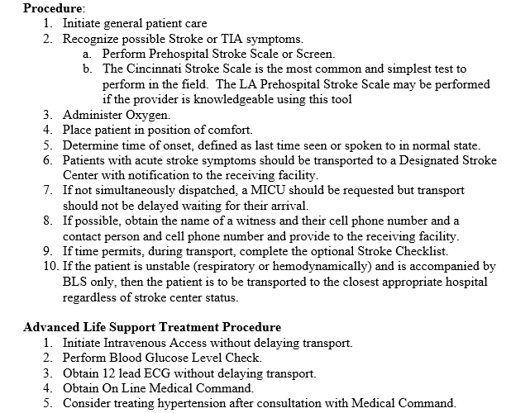
NJ Department of Health,
Office of Emergency Medical Services
Prehospital Stroke Guidelines*
*Developed for prehospital providers including BLS and ALS and apply to care of all patients with possible stroke and TIA symptoms

Slide 9


Opportunities to Improve Stroke Care in NJ
When patients are routed to an appropriate hospital, patient outcomes (e.g., morbidity and mortality) and hospital resources can be maximized.
There is an opportunity to improve stroke care by supporting EMS routing decision-making through stroke identification and severity assessment tools.
Notes:
EMS can help early identification of those potentially needing advanced stroke care, as well as those who may not need to be routed for advanced stroke care.

Slide 10
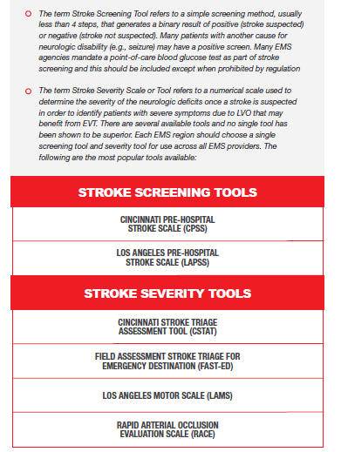
From the AHA/ASA Mission: Lifeline
“Severity-Based Stroke Triage Guidelines for EMS”:
Notes:
Describe 1. Stroke Screening Tool and purpose and 2. Stroke Severity Scale and purpose. Highlight that there are several stroke severity tools and no single tool has been shown to be superior. Experts from AHA’s Mission: Lifeline program recommend each EMS region choose a single screening tool and severity tool for use across all providers.

Slide 11
Statewide Stroke Severity Scale
NJ stakeholders have been convening to discuss a statewide stroke severity scale
Scale considerations include:
Sensitivity and specificity of scale
Which scale are agencies currently using
Ease of adding scale to current stroke identification processes
Stroke Advisory Panel (SAP), NJ Stroke Coordinator Consortium (NJSCC), and NJ EMS Council to submit scale recommendation to state EMS bodies for consideration? - TBD

Slide 12
Discussion and Q&A
Notes:
Some questions to ask the audience, if further discussion is needed:
If a statewide stroke severity scale is implemented, what education do you all feel will be important for ALS and BLS?
How do you think ALS and BLS stroke severity scale education can be successfully disseminated in NJ?
What criteria is considered for/against bypassing a primary center for a comprehensive center?
Feedback on which stroke severity scale for LVO?
Does your ED activate a stroke code based on pre-notification from EMS? What is the criteria for doing so?
Feedback on having a statewide standard on stroke assessment tools in the ED?
Does your hospital do CT head with CTA upon arrival?
Feedback on developing statewide transfer protocols for stroke patients?

