Slide 1
When to Stop: Diminishing Returns from Additional Thrombectomy Passes
Scott B. Raymond MD PhD, Matthew J. Koch MD, James D. Rabinov MD, Thabele Leslie-Mazwi MD, Christopher J. Stapleton MD, Aman B. Patel MD
Massachusetts General Hospital
Harvard Medical School

Slide 2
Disclosures
Scott B. Raymond MD PhD
  No disclosures
Aman B. Patel PhD
  Financial Disclosure:
  Consultant – Medtronic, Penumbra

Slide 3
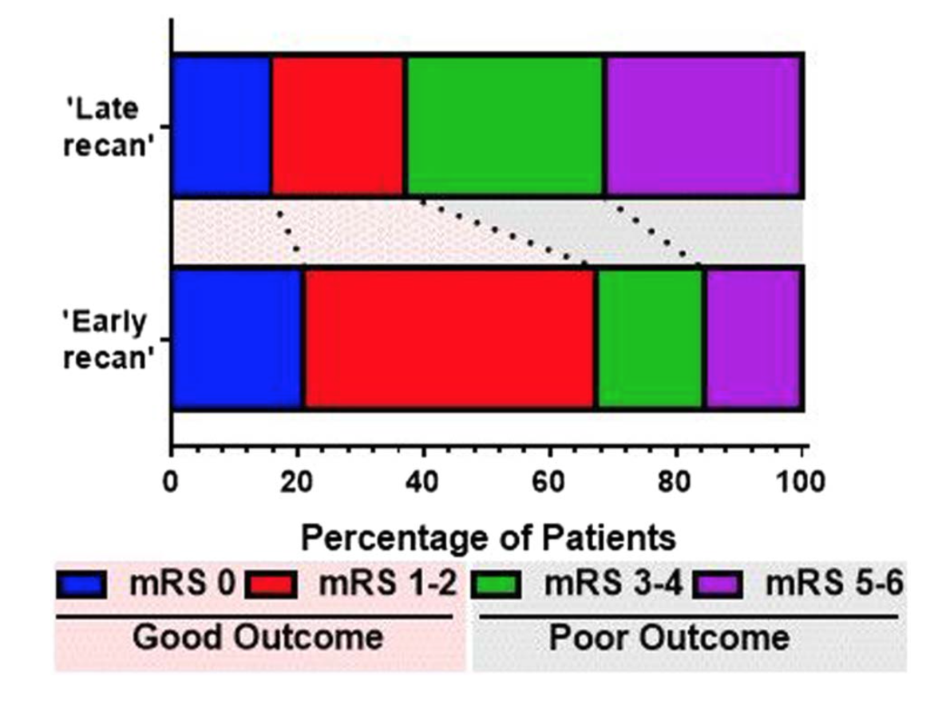
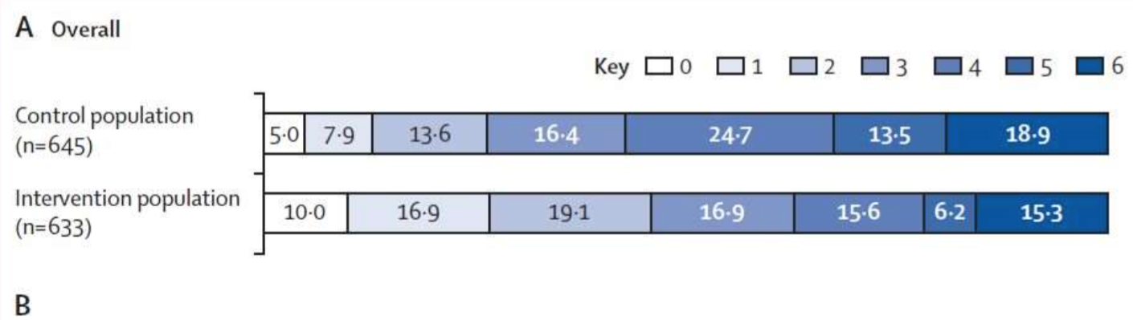
Introduction
Recanalization sometimes requires repeated attempts and prolonged procedures.
Thrombectomy is the most effective therapy for acute large vessel occlusion.
HERMES trial, Goyal et al, Lancet, 2016
Alawieh et al, JNIS, 2018

Slide 4
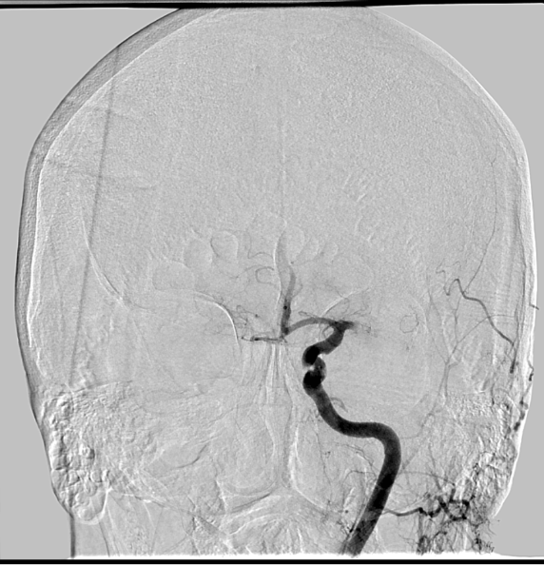
QUESTION
What is the appropriate next step?
Combined aspiration/stentriever
Repeat stentriever
Try different stentriever
Abort thrombectomy
Post ADAPTx1, Stentriever x2
89F, LSW 6 hrs, NIHSS 15, L ICA T, DWI 55 cc

Slide 5
Factors in Refractory Occlusion
Sharp angle at ICA or MCA bifurcation
(Schwaiger et al, AJNR, 2015)
Superimposed intracranial atherosclerosis
    (Gascou et al, AJNR, 2014; Kim et al, AJNR, 2016)
Clot length
(Yoo et al, Stroke, 2017)
Clot composition
    (Mokin et al, JNIS, 2015)
Lack of prior IV tPA
    (Mistry et al, Stroke, 2017)

Slide 6
Study Design
Retrospective review of 198 LVO patients
  - 8 patients excluded because distal access was not possible
Angiography and reports reviewed
  - TICI score assigned after each pass
  - Success: TICI 2b or 3
Stratified by number of passes (1-3 or > 3)

Slide 7
Results: Thrombectomy Passes
A
B

Slide 8
Results: Thrombectomy Passes
 |  | Passes
Characteristic | Total | 1-3 | >3 | p <
N | 190 | 172 | 18
Male | 94 | 85 | 9 | .99
Female | 96 | 87 | 9
Age | 69 | 69 | 72.5 | 0.8
NIHSS | 16 | 16 | 16 | 0.7
ASPECTs | 8 | 8 | 8 | 0.2
DWI Vol (cc) | 17 | 17 | 22 | 0.3
tPA | 111 | 105 | 6 | .05
Passes, median | 2 (1-3) | 1 | 4
Procedure Duration | 57 | 54 | 113 | 0.001
Each pass ~ 20 minutes

Slide 9
Results: Thrombectomy Passes
 |  | Passes
Outcome | Total | 1-3 | >3 | p <
N | 190 | 172 | 18
Complications | 18 (9) | 15 (9) | 3 (17) | 0.6
SAH | 4 (2) | 3 (2) | 1 (6) | 0.4
SICH | 17 (9) | 14 (8) | 3 (17) | 0.3
TICI 2b/3 | 146 (77) | 139 (81) | 7 (39) | 0.001
mRS 0-2 | 81 (49) | 78 (48) | 3 (17) | 0.02
CMO | 23 (12) | 19 (11) | 4 (22) | 0.5

Slide 10
Summary
Reperfusion is usually achieved after 3 passes (>70%).
Refractory occlusion requiring > 3 passes are much less likely to recanalize (< 40%) or have good outcomes (< 20%).

Slide 11
Conclusions
Thrombectomy can be stopped after 3 passes based on futility (unlikely to help).
Although associated risks are expected to increase with additional passes, this observation was not statistically significant.
Attempts beyond 3 passes should be used very sparingly in the context of an individual patient.

Slide 12
References
Goyal et al. Endovascular thrombectomy after large-vessel ischaemic stroke: a meta-analysis of individual patient data from five randomised trials. Lancet. 2016;387(10029):1723-31.
Alawieh et al. The golden 35 min of stroke intervention with ADAPT: effect of thrombectomy procedural time in acute ischemic stroke on outcome. J Neurointerv Surg. 2018;10(3):213-220.
Schwaiger et al. The curved MCA: influence of vessel anatomy on recanalization results of mechanical thrombectomy after acute ischemic stroke. AJNR Am J Neuroradiol. 2015;36(5):971-976.
Gascou et al. Stent retrievers in acute ischemic stroke: complications and failures during the perioperative period. AJNR Am J Neuroradiol. 2014;35(4):734-740.
Kim et al. Effect of intracranial atherosclerotic disease on endovascular treatment for patients with acute vertebrobasilar occlusion. AJNR Am J Neuroradiol. 2016;37(11):2072-2078.
Mokin et al. Thrombus density predicts successful recanalization with Solitaire stent retriever thrombectomy in acute ischemic stroke. J Neurointerv Surg. 2015;7(2):104-107.
Yoo et al. Impact of thrombus length on outcomes after intra-arterial aspiration thrombectomy in the THERAPY Trial. Stroke. 2017;48(7):1895-1900.
Mistry et al. Mechanical thrombectomy outcomes with and without intravenous thrombolysis in stroke patients: a meta-analysis. Stroke. 2017;48(9):2450-2456.

