Slide 1
NECC 2018
Rhode Island
Kenneth A Williams, MD, FACEP
Medical Director, RI DOH Center for EMS

Slide 2
Disclosures
No financial conflicts
Work at RIH
Employed by BPI / Brown Emergency Medicine
LifePACT Medical Director
RI DOH Center for EMS Medical Director
Chair, NASEMSO MDC

Slide 3
Goals
Maintaining excellence
What’s next?
BioSpatial GIS data and Stroke Syndrome

Slide 4
Maintaining Excellence
Prevention and Awareness
EMS Triage
Rapid door to CT / CTA
CTA for EVERY Code Stroke – it is a vascular disease – image the vessels!
ELVO transfer
CSC, Express Care / LifePACT or equivalent RIGHT AWAY
tPA if indicated
TIA workup
Ancillary care
Swallow screen
Rehab

Slide 5
International Stroke Conference
2018 JAN Los Angeles, CA
Abstract presented using RI data.
Work in progress on work using MA and RI data

Slide 6


EMS Triage to CSC Reduces Time To Treatment And Improves Outcomes In Patients With Large Vessel Occlusion
Mahesh V. Jayaraman^{1,2,3,4} M.D., Morgan L. Hemendinger² B.A., Grayson L. Baird^{1,5} Ph.D., Shadi Yaghi^{2,4} M.D., Shawna Cutting^{2,4} M.D., Ali Saad^{2,4} M.D., Matthew Siket⁶ M.D., Tracy E. Madsen⁶ M.D., Kenneth Williams⁶ M.D., Karen L. Furie^{2,4} M.D., M.Ph, Ryan A. McTaggart^{1,2,3,4} M.D.
Departments of Diagnostic Imaging (1), Neurology (2), Neurosurgery (3) and Emergency Medicine (6)
Warren Alpert School of Medicine at Brown University
The Norman Prince Neuroscience Institute (4) Lifespan Biostatistics Core (5)
Rhode Island Hospital
Providence, RI

Slide 7
Disclosure statement
None of the authors have any relevant financial conflicts of interest

Slide 8
Background
Thrombectomy for anterior circulation ELVO stroke is dramatically effective, but the treatment effect is markedly time-dependent
Re-organizing systems of care to ensure prompt access to thrombectomy is now a major focus worldwide
Notes:
Increased ambulance use
Decay of OSC skill set
Psychosociology of being treated further from home

Slide 9
Improving access to MT
Field Diversion
Transport High-likelihood ELVO directly to CSC based on field severity threshold
Mobile Stroke Units
Improving PSC workflow
Scan in the field, administer IV tPA and transport to
most appropriate center
Develop innovative transfer processes for patients presenting to PSCs

Slide 10
Purpose
To examine the impact of implementing both an optimized PSC transfer workflow and severity based field triage algorithm on times to treatment and patient outcomes within a single state

Slide 11
Rhode Island
2nd highest US state in population density
1 CSC
  900,000 population within 20 minutes of CSC
8 PSCs
  6 within 15 minutes of CSC
1 ASRH

Slide 12
Time Epochs
July 2015
Jan 2016
Jan 2017
Jan 2018
Notes:
To understand the care transformation that occurred in RI I want to introduce you to 3 time epochs

Slide 13
Time Epochs
Pre-optimization
Pre-triage
July 2015
Jan 2016
We met with all PSCs in the region
Educated on a standardized PSC ELVO protocol
RI Stroke Task Force agreed to and designed a severity based triage protocol

Slide 14

Our PSC ELVO Protocol
3 important steps then occur in parallel
LAMS 4-5
Notify CSC
CT & CTA
LifeIMAGE
CSC Transfer center called, notified of LAMS 4/5 patient,
Prior to imaging
CT & CTA on first trip to scanner
Do not wait for Creatinine
Setup and install secure cloud based image sharing platform with CSC

Slide 15
Time Epochs
Pre-optimization
Pre-triage
PSC Optimization
Pre-triage
July 2015
Jan 2016
Jan 2017
Iterative PSC ELVO protocol feedback on all PSC transfers
EMS field triage concept introduced, LAMS education started
Severity based triage NOT mandatory

Slide 16
Rhode Island Stroke Triage
Field LAMS 4+ and within 30’ of CSC:
  Go directly to CSC
Field LAMS <4
  Go to closest PSC/CSC
Field LAMS 4+ and >30’ to CSC:
  Go to PSC, pre-notify with LAMS
  PSC goal DIDO <45 minutes
Execute to 24h from LKW

Slide 17
Time Epochs
Pre-optimization
Pre-triage
PSC Optimization
Pre-triage
PSC Optimization
Field Triage
July 2015
Jan 2016
Jan 2017
Jan 2018
Extensive EMS education effort launched
Field triage required
Iterative feedback on appropriately and inappropriately triaged patients to EMS
Ellie Dibiasio
Hall H 6:15-6:45
Notes:
#TP227 in hall H
615-645pm

Slide 18
Study population
Consecutive Rhode Island stroke patients with EMS as first medical contact
  Anterior circulation LVO
  Initial NCCT (at PSC or CSC) ASPECTS >5
Divided into aforementioned time epochs

Slide 19
Demographics collected
Age
Admission NIHSS
Time from LKW to EMS Scene arrival
Closest stroke center to patient
If PSC was closest, PSC or CSC

Slide 20
Outcomes
Workflow parameters - First hospital arrival (be it PSC or CSC) to:
  Alteplase
  Arterial puncture
  Recanalization (mTICI 2b or better)
Clinical outcomes
  Favorable outcome defined as mRs 0-2 at 90 days, or discharge NIHSS ≤ 4 for those not yet at 90d follow-up (limited to those patients with mRs 0-2 pre-procedure)

Slide 21
Demographics
 | Epoch I: Pre-optimization Pre-triage | Epoch II: PSC optimization Pre-triage | Epoch III: PSC optimization Field triage
Number (per month) | 38 (6.3 per month) | 100 (8.3 per month) | 94 (7.8 per month)
Age in years, median [IQR] | 76 [69 – 89] | 78 [67 – 86] | 77 [65 – 85]
NIHSS, median [IQR] | 19 [14 – 23] | 18 [12 – 24] | 16 [12 – 22]
Stroke onset to EMS arrival in minutes, median [IQR] | 42 [17 – 75] | 58 [17 – 193] | 46 [16 – 238]
No statistically significant differences

Slide 22
Field locations
Actual field location obtained from review of EMS run sheets
Google Maps API used to calculate distance and time to:
  Closest PSC
  CSC
Categorized into:
  CSC Closest
  PSC Closest, taken to CSC (Field triage)
  PSC Closest, taken to PSC (Interfacility transfer)

Slide 23
Field Locations
In a densely populated urban area with multiple PSCs, most patients are closest to a PSC in the field
Median [IQR] additional time from field to CSC:
8 [4-12]

Slide 24
Impact of triage
Field triage to CSC (For those closer to a PSC) increased from 35% to 71% during the study time period
p=.03 between Epoch I and III
Notes:
Signifcant increase, p=.0153
I vs III p=.015
I vs II p=.31
II vs III p=.032

Slide 25
Outcomes: Workflow
 | Period I: Pre-optimization Pre-triage | Period II: PSC optimization Pre-triage | Period III: PSC optimization Field triage
EMS Scene departure to first hospital arrival in minutes, median [IQR] | 10 [9 - 15] | 11 [8 - 17] | 14 [8 – 17]
Direct to CSC (%) | 55% | 66% | 77%
First Hospital Arrival to: (all in minutes, median [IQR])
IV Alteplase | 54 [40 – 74] | 49 [32 – 66] | 36 [27 – 51]
Arterial puncture | 105 [76 – 137] | 101 [74 – 144] | 88 [54 – 128]
Recanalization | 156 [96 – 179] | 132 [106 – 176] | 116 [84 – 156]
Differences showed a trend, not statistically significant
Notes:
SCENE to first hospital arrival Not significant
First hospital to tpa p=.006 Group I vs III
First arrival to angiogram NOT significant
First arrival to recan NOT Significant

Slide 26
Clinical Outcomes – All patients
p=.049 between I and III
Favorable outcome defined as mRs 0-2 at 90 days or Discharge NIHSS ≤ 4 for those not yet at 90d follow-up
Notes:
31, 51, 59
I vs III p=.0499

Slide 27
The real question:
What if the PSC is closest?
Pre-optimization
Pre-triage
PSC Optimization
Pre-triage
PSC Optimization
Field Triage
PSC Closest, Triaged to CSC
PSC Closest, Taken to PSC
CSC Closest
Notes:
No one ever gets hurt going to a CSC but are they hurt by bypass?

Slide 28
The real question:
What if the PSC is closest?
Pre-optimization
Pre-triage
PSC Optimization
Pre-triage
PSC Optimization
Field Triage
PSC Closest, Triaged to CSC
PSC Closest, Taken to PSC
CSC Closest

Slide 29
Field triage vs. PSC first: Workflow
 | Direct to CSC (n=94) | Taken to PSC (n=56) | p Value
NIHSS, median [IQR] | 17 [11 – 24] | 16 [13 – 23] | 0.92
EMS Scene departure to first hospital arrival | 16 [11 – 19] | 8 [5 – 11] | p<.001
EMS Scene departure to:
IV Alteplase | 51 [43 – 64] | 68 [50 – 86] | p=.012
Arterial puncture | 98 [70 – 128] | 155 [113 – 214] | p<.001
Recanalization | 131 [100 – 157] | 174 [142 – 257] | p<.001
Despite 8 additional minutes of drive time, all workflow parameters (IV alteplase, arterial puncture and recanalization) were significantly faster.
Notes:
Scene to first hospital p<.001
Scene to tpa: p=.0118
Scene to puncture: p<.001
Scene to recan: p<.001
NIHSS .92

Slide 30
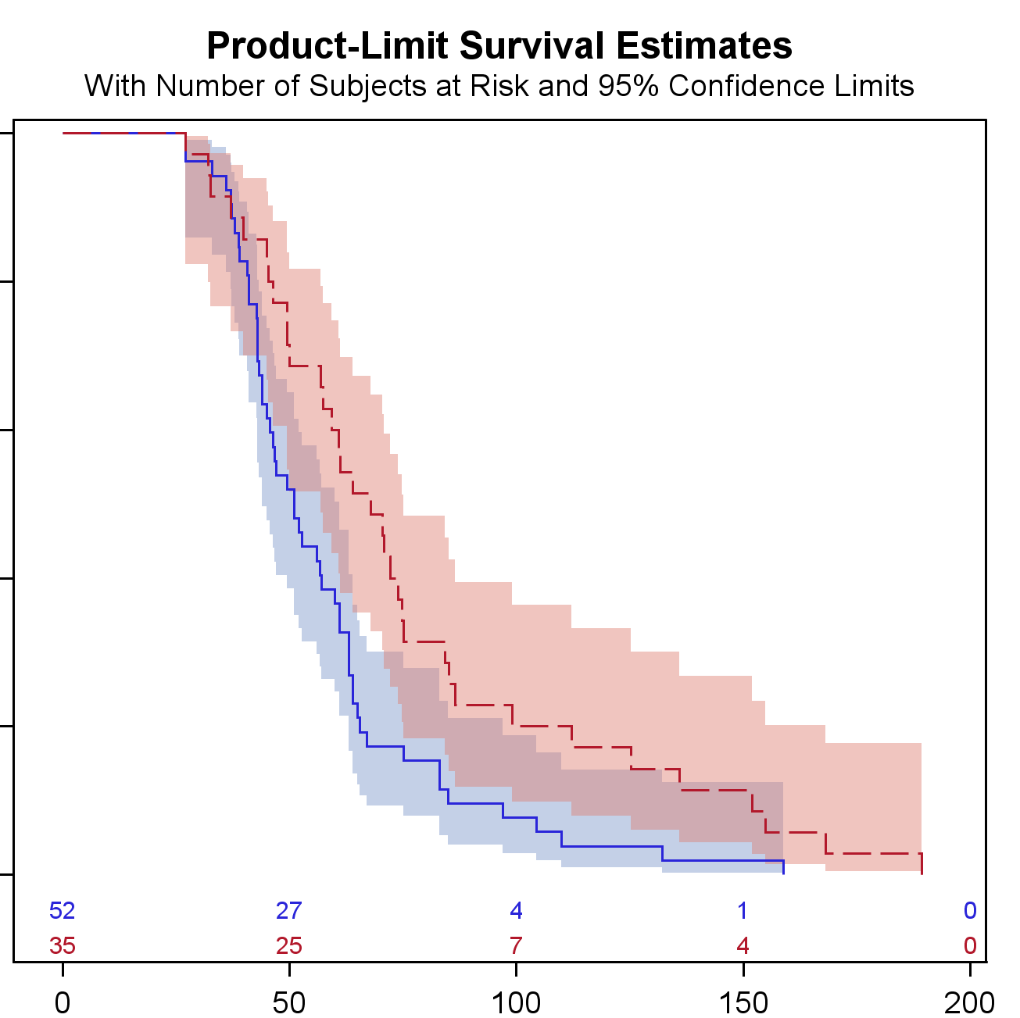
EMS Scene departure to IV tPA
Closest PSC
Direct to CSC
Despite 8 additional minutes of drive time, IV tPA was administered 17 minutes faster.
p=.012

Slide 31
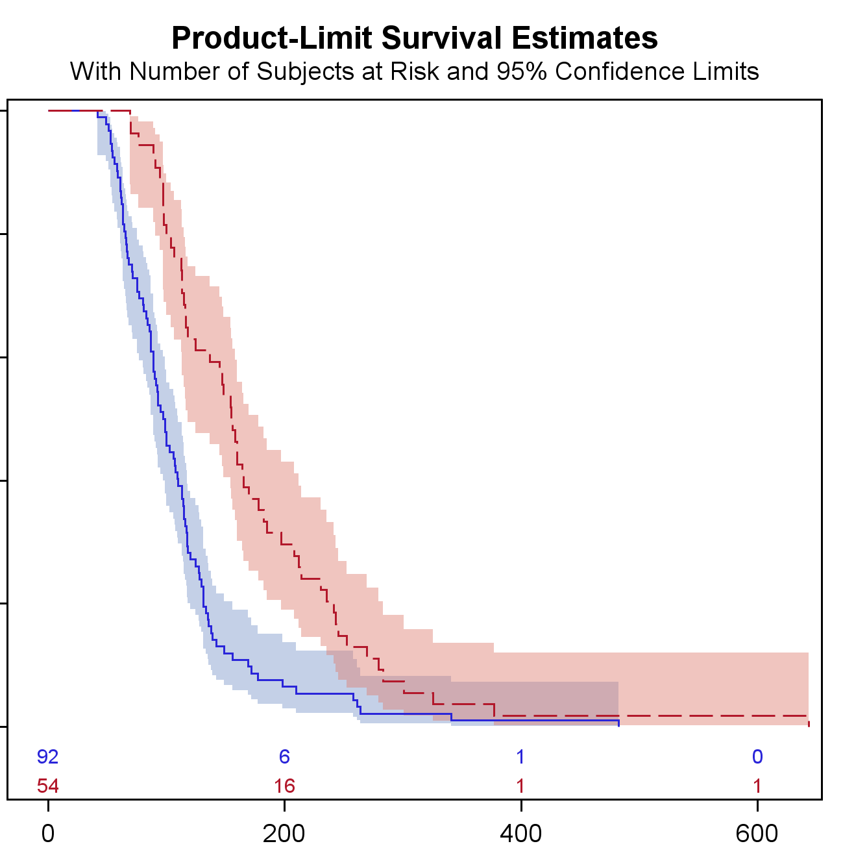
EMS Scene departure to arterial puncture
Closest PSC
Direct to CSC
Despite 8 additional minutes of drive time, Angiogram started 57 minutes earlier.
p<.001

Slide 32
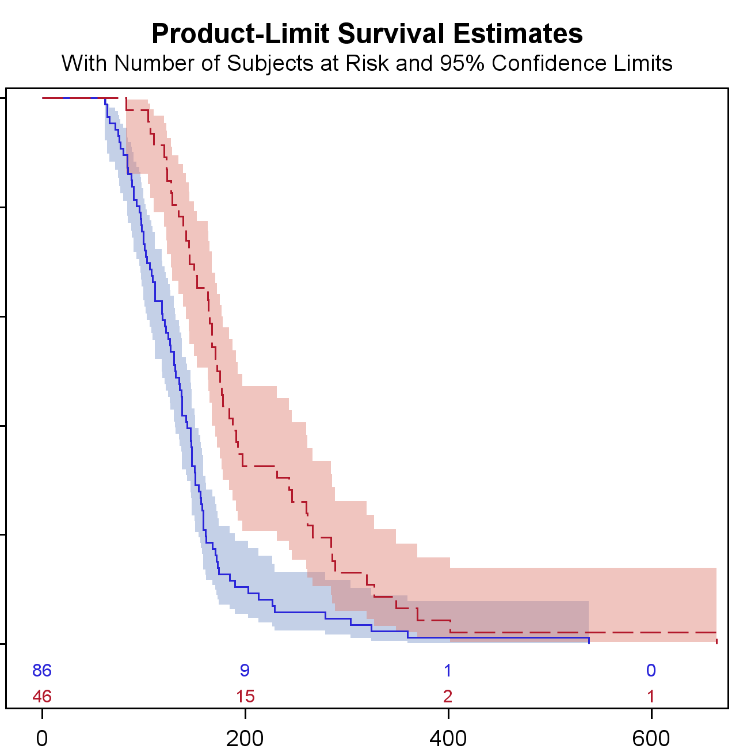
EMS Scene departure to recanalization
Closest PSC
Direct to CSC
Despite 8 additional minutes of drive time, recanalization was 43 minutes earlier.
p<.001

Slide 33
Field triage vs. PSC first: Outcomes
Patients Triaged directly to CSC had significantly better outcomes (p=.01)
p=.01
Favorable outcome defined as mRs 0-2 at 90 days or Discharge NIHSS ≤ 4 for those not yet at 90d follow-up
Notes:
P=.0129

Slide 34
Limitations
Single geographic region with a single CSC
Densely populated region
Generalizability of results to other regions is unknown
Denominator
  Not every patient gets a CTA
  Not every patient had a recorded field LAMS score

Slide 35
Conclusions
We can improve outcomes across an entire region using:
  Pre-hospital field triage #go2CSC for suspected ELVO patients
  Standardized PSC ELVO protocols
For patients closer to a PSC but within 30 minutes of a CSC EMS triage to the CSC results in:
  Faster treatment with alteplase, earlier groin puncture and recanalization (even with an optimized PSC transfer protocol)
  Improved outcomes

Slide 36
Lessons
EMS Triage of stroke patients is working in RI.
Similar to Trauma and STEMI, triage results in faster care and better outcomes.
Go RI!

Slide 37
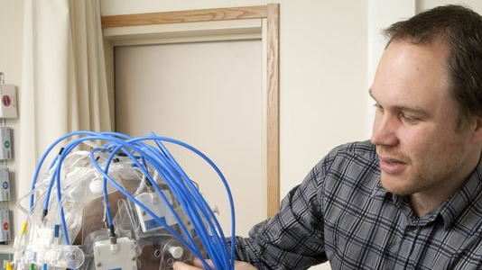
What’s Next?
Novel therapies
Thrombectomy for larger infarct cores – may be a benefit
Longer interventional treatment window
24 hours is just a start….
New field diagnostic tools
Microwave Strokefinder helmet?
Preventive screening and treatment
TIA evaluation and more….
Interstate EMS triage and data sharing
LAMS, FAST-ED, RACE, etc…..
Telemedicine
EMS to ED, ED to Stroke Center, etc….

Slide 38

Stroke IR Suite in RIH ED
This Photo by Unknown Author is licensed under CC BY-NC-ND

Slide 39
Lessons
Stroke care keeps evolving!

Slide 40
BioSpatial & Stroke Syndrome

Slide 41
BioWho?

Slide 42
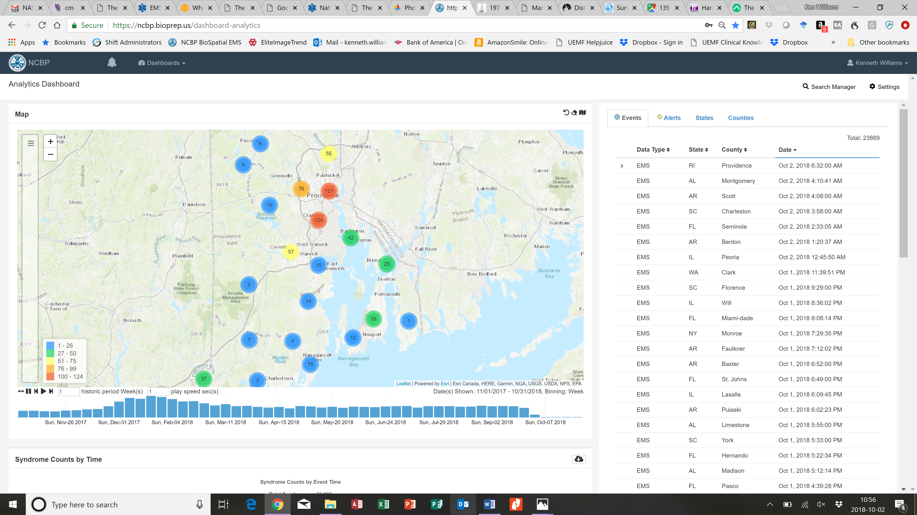

Slide 43
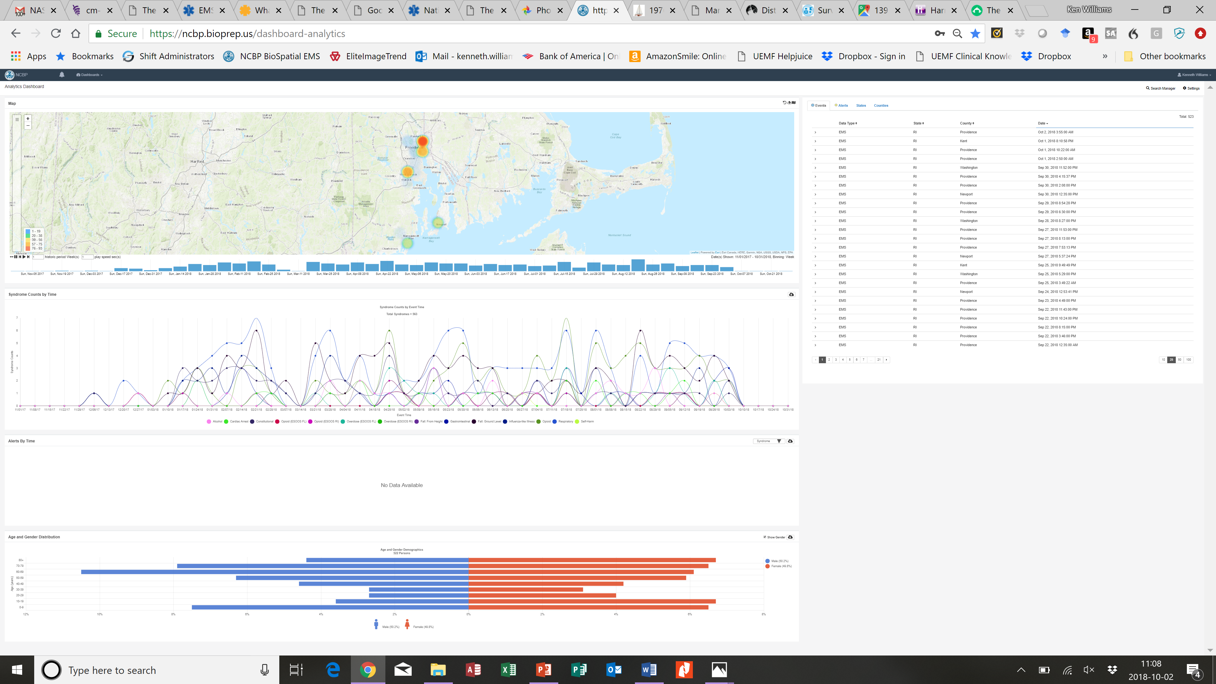
LifePACT trailing 12 months as heatmap

Slide 44
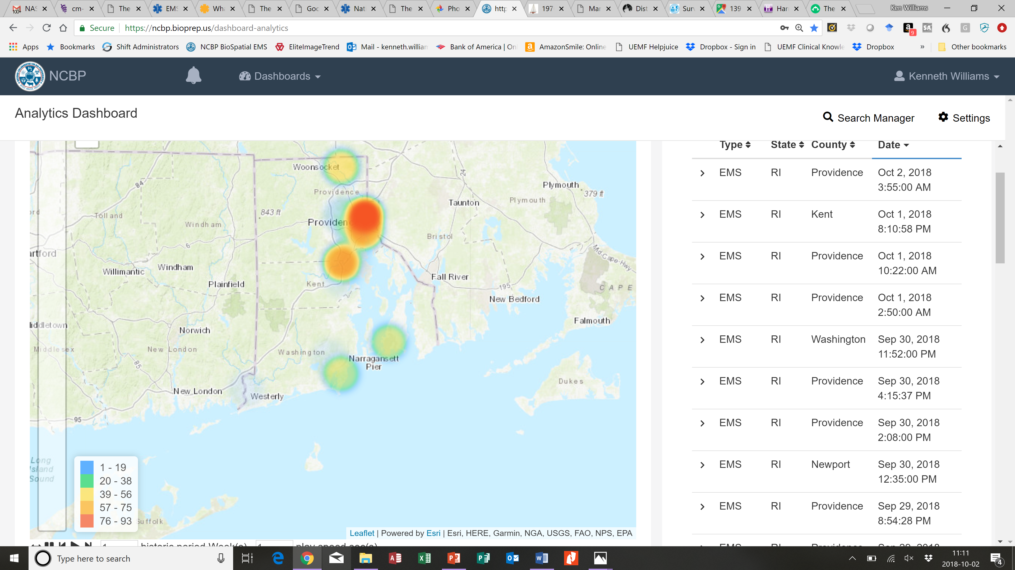
LifePACT trailing 12 months heat map

Slide 45
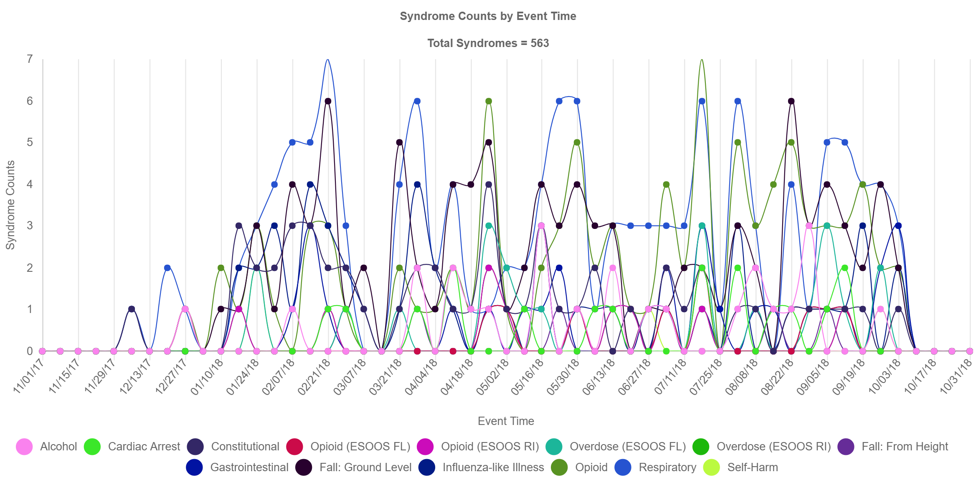
LifePACT trailing 12 months syndromes

Slide 46
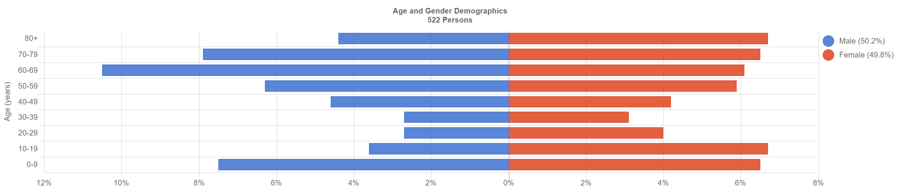
LifePACT 2018 OCT trailing 12 months

Slide 47
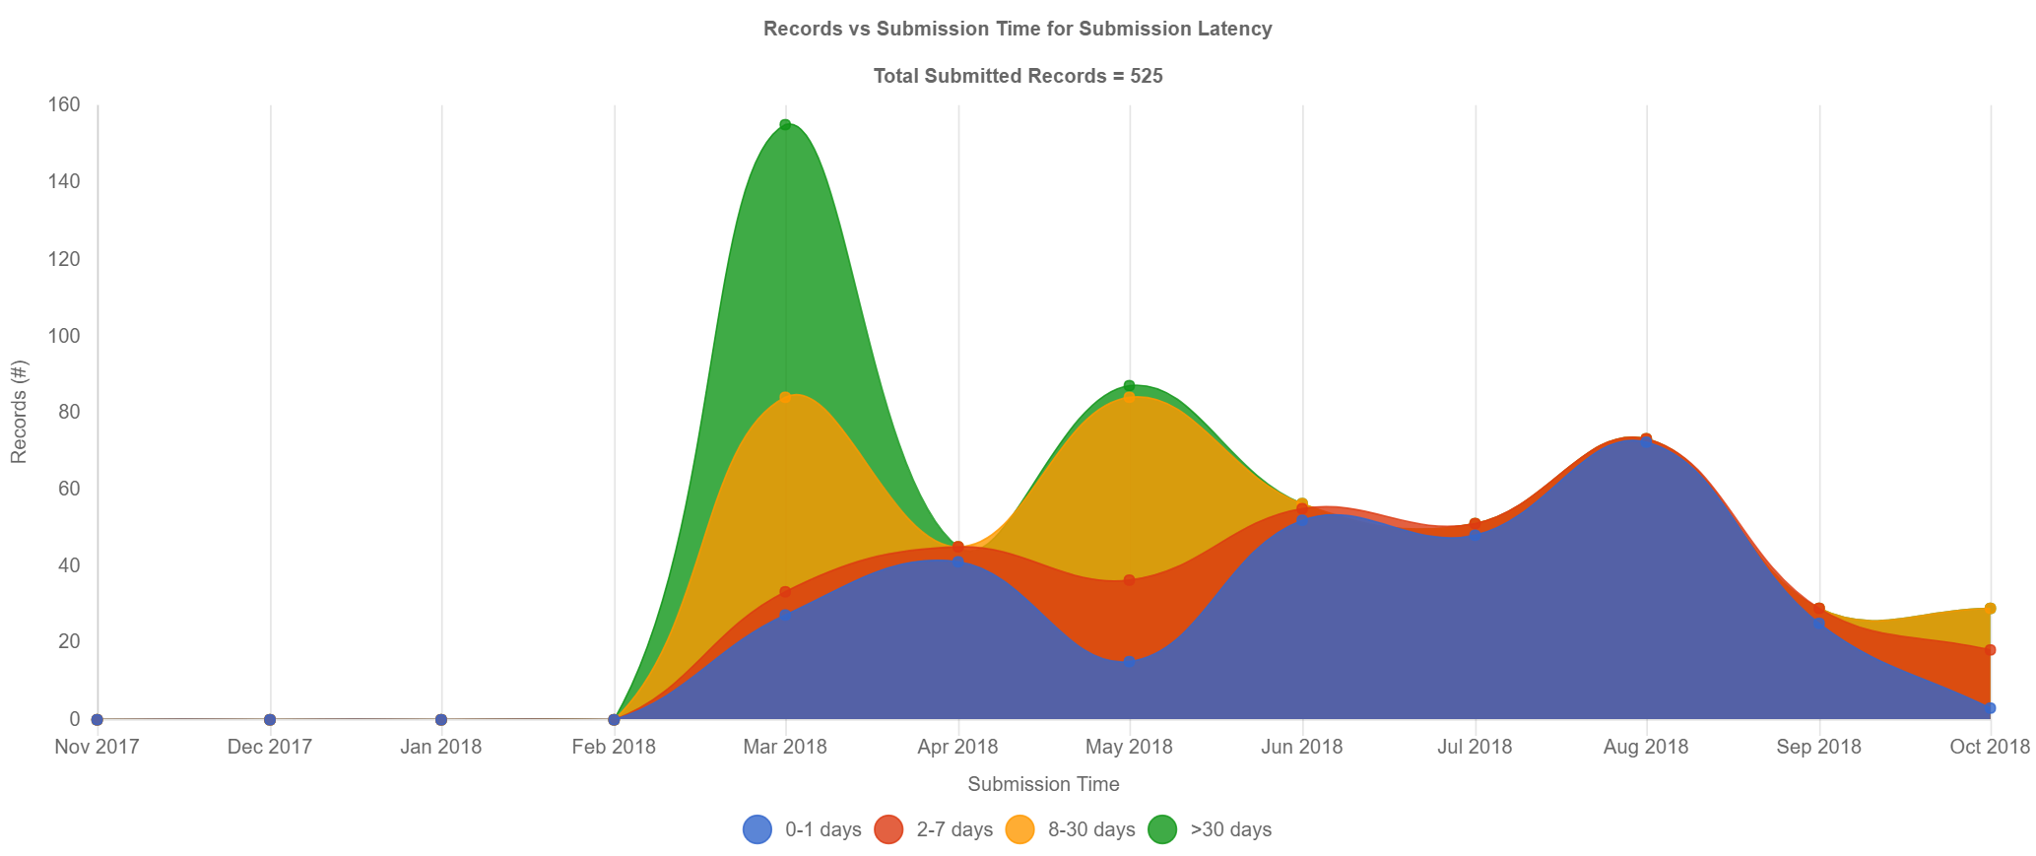
LifePACT submission latency since inception

Slide 48
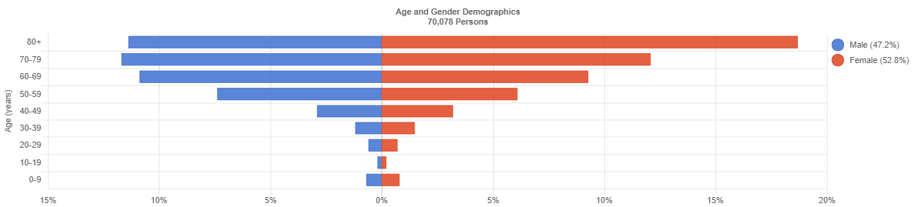
Stroke Syndrome RI Trailing Year

Slide 49
Lessons
BioSpatial is a powerful GIS product for EMS data analysis.
Stroke is a new Syndrome – we can help improve it!

Slide 50
Summary
Rhode Island is amazing, but we can be even better!
Let’s be open to new / next therapies and research.
New tools like BioSpatial GIS analysis will help guide future interventions.

Slide 51
Audience Question 1
What is the most important measure of stroke system quality?
A] ED door to CT time.
B] ED door to tPA needle time.
C] Discharge / 90 day patient outcome using mRs / NIHSS
D] Change in NIHSS after tPA

Slide 52
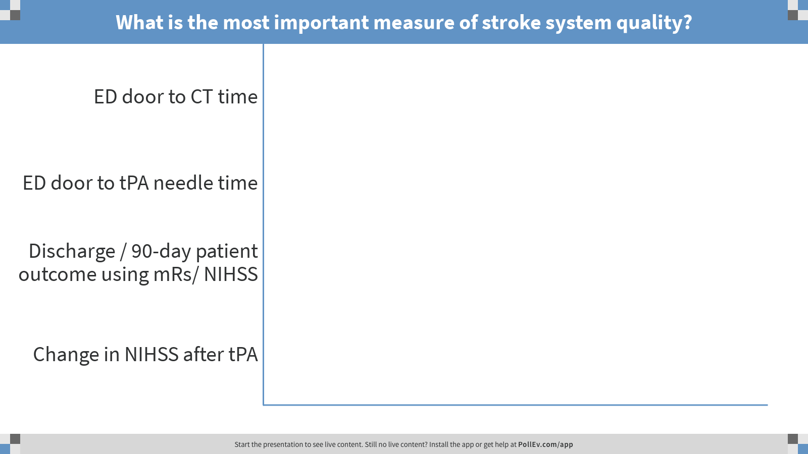
Notes:
Poll Title: What is the most important measure of stroke system quality?
https://www.polleverywhere.com/multiple_choice_polls/Vmsy7piYkMzG42S

Slide 53
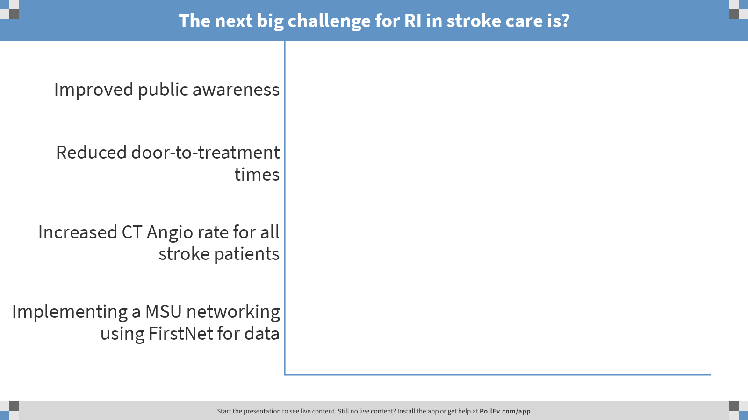
Notes:
Poll Title: The next big challenge for RI in stroke care is?
https://www.polleverywhere.com/multiple_choice_polls/JjDeb605sr05c8S

Slide 54
Audience Question 2
The next big challenge for RI in stroke care is:
A] Improved public awareness.
B] Reduced door-to-treatment time.
C] Increased CT Angio rate for all stroke patients.
D] Implementing a MSU network using FirstNet for data

Slide 55
Questions?
Ken Williams
kwilliamsMD@gmail.com

