Slide 1


CTA Collaterals vs CT Perfusion CBF Maps for
Core Infarct Volume Assessment and
Transfer Decision-Making for Intra-Arterial Thrombectomy
Kamalian S¹, McWilliams SR¹, Raymond SB¹, Mansouri M¹, Hakimelahi R², Leslie-Mazwi TM³, Schaefer PW¹, Schwamm LH⁴, Gonzalez RG¹, Lev MH¹
1. Department of Radiology, Massachusetts General Hospital, Boston.
2. Department of Radiology, Memorial Sloan Kettering Cancer Center, New York.
3. Neuroendovascular Program, Massachusetts General Hospital, Boston.
4. Stroke Service, Massachusetts General Hospital, Boston.

Slide 2

Disclosures
Michael H. Lev
– GE (consultant, stock<$10K)
– Takeda (consultant)
– Siemens (institutional software)
Other authors have no disclosures

Slide 3
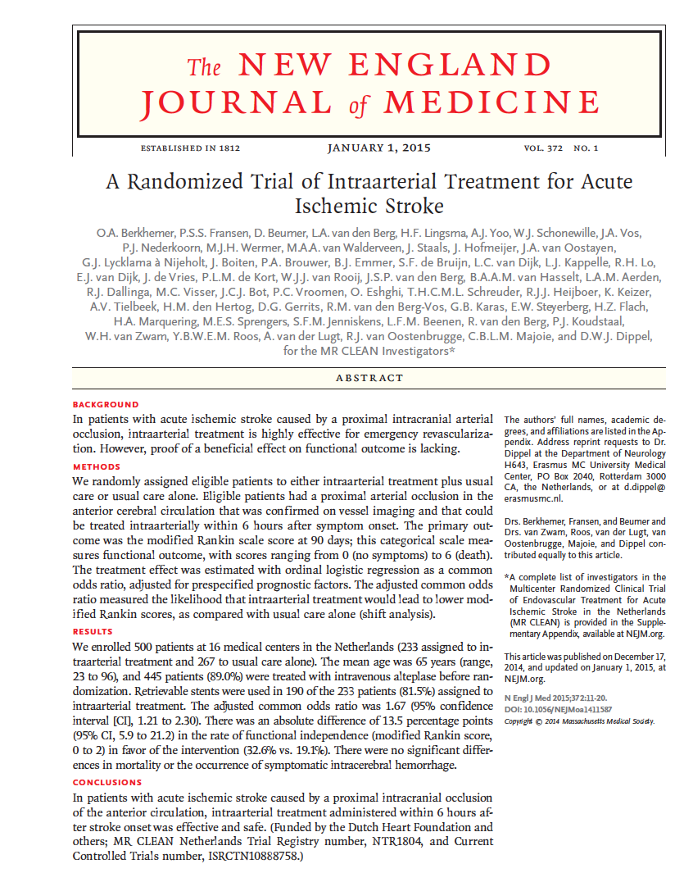
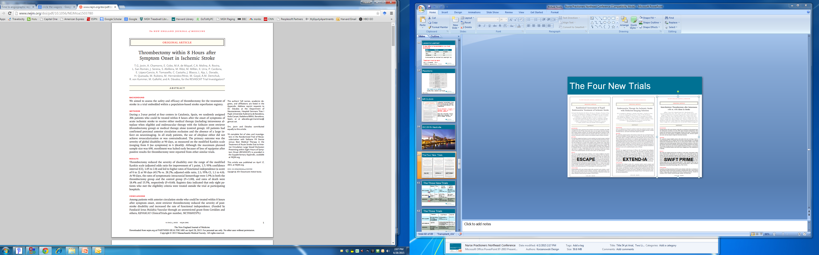
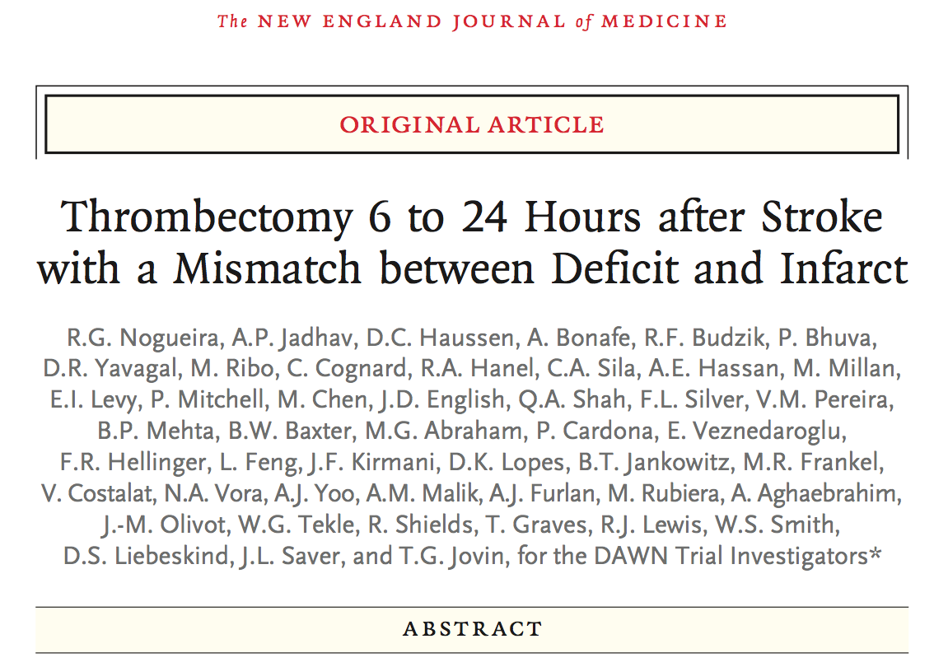
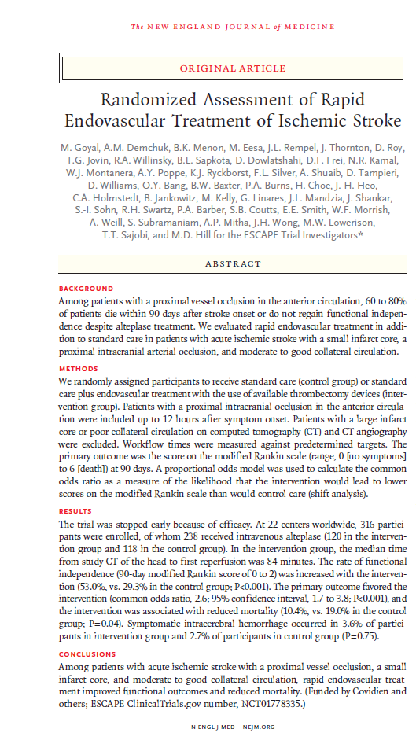
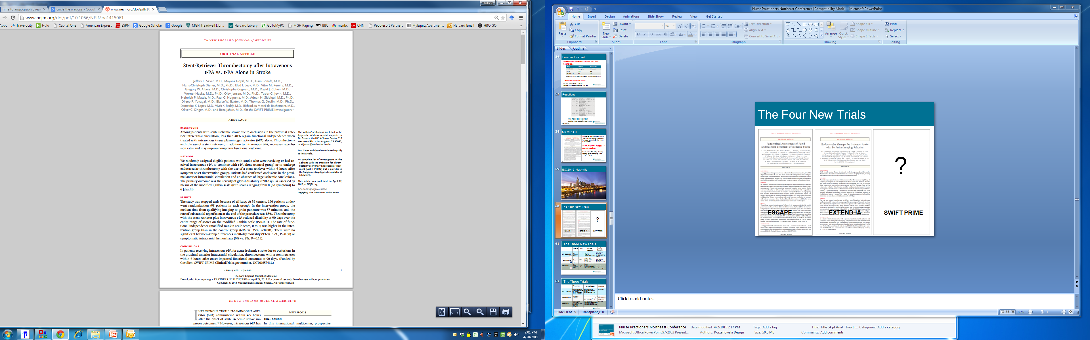
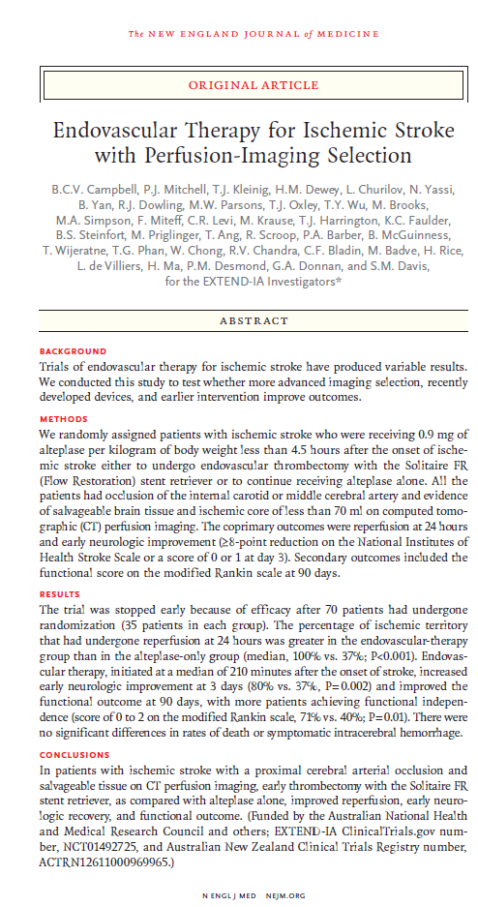
CTA is the New Standard of Care in triage of patients for IAT
MR CLEAN
ESCAPE
EXTEND-IA
SWIFT PRIME
REVASCAT
THRACE
THERAPY
DAWN
DEFUSE 3

Slide 4





Comprehensive Stroke Center
- or
-Thrombectomy-Capable Stroke Center
Current Stroke
Triage System
Primary Stroke Center
Primary Stroke Center
Acute Stroke Ready Hospital
Acute Stroke Ready Hospital
Modified from “Bay” Leslie-Mazwi, MD

Slide 5
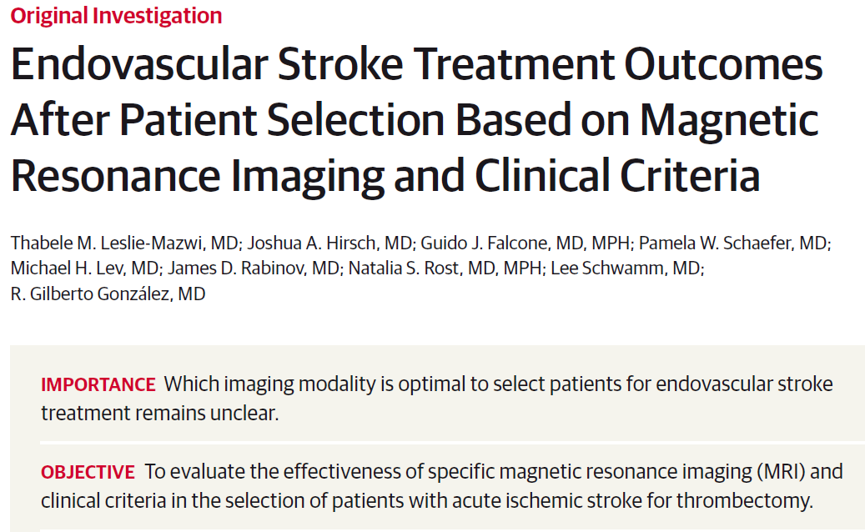
Background
3 Categories of Infarct Core volume involved in IAT patient selection:
    DWI < 70 ml: “Likely to Benefit”
    DWI 70-100 ml: “Uncertain to Benefit”
    DWI > 100 ml: “Unlikely to Benefit”
2 Considerations in Patient Transfer Decisions
    Err on the side of transferring, to avoid
    under-treatment ...
    … however, also avoid inappropriate utilization
    of resources by unnecessary transfer.

Slide 6
Hypothesis & Study Design
3 Categories of Infarct Core volume involved in IAT patient selection:
    DWI < 70 ml: “Likely to Benefit”
    DWI 70-100 ml: “Uncertain to Benefit”
    DWI > 100 ml: “Unlikely to Benefit”
Study Design for ”Transfer to Hub” Decision:
    “Malignant” vs “Non-malignant”
    DEFINITION of “malignant” on CTA =
        Absent or markedly decreased collaterals over >50% of MCA territory – OR –
        Marked GM/WM hypo-enhancement on CTA with volume > 100 ml
Hypothesis Regarding CTA collaterals status & hypo-enhancement size:
    “Likely to Benefit”: “Non-malignant”
    “Uncertain to Benefit”: “Non-malignant”
    “Unlikely to Benefit”: “Malignant”

Slide 7
Goal & Methods
Comparison between …
    2 different commercially available CTP software platforms (“CTP A” & “CTP B”), vs
    3 different reader levels-of-experience interpretation of CTA collaterals and hypo-enhancement
… for estimation of DWI “core” infarct volume of < or > 100 ml
3 different reader levels-of-experience:
    2 CAQ-level Staff Neuroradiologists (consensus)
    ED Radiology 1st year Fellow
    Neuro-IR Fellow (2-yrs neuroimaging experience)
N=55 consecutive patients with anterior circulation acute ischemic stroke who underwent CTA, CTP, & DWI-MRI within 1-hour of presentation.
Hypo-enhancing “core” volume on the CTA estimated by:
(L x W x H)/2

Slide 8
Methods
Patients were stratified by DWI core volume into >100ml and <100ml
Sensitivities and specificities were calculated for each CTP software platform and each reader’s CTA score
Inter-observer agreement was calculated with the Kappa statistic

Slide 9
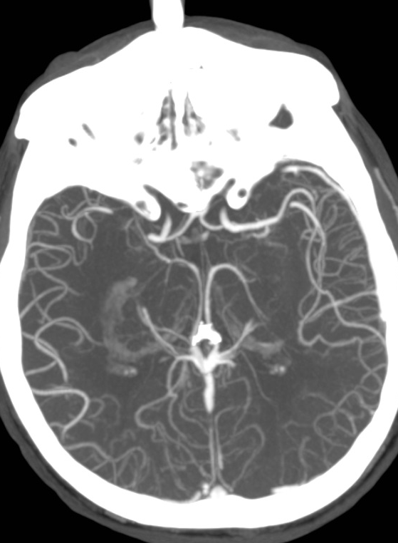
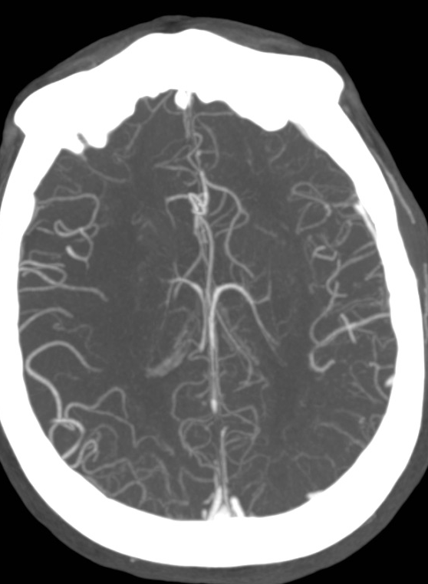
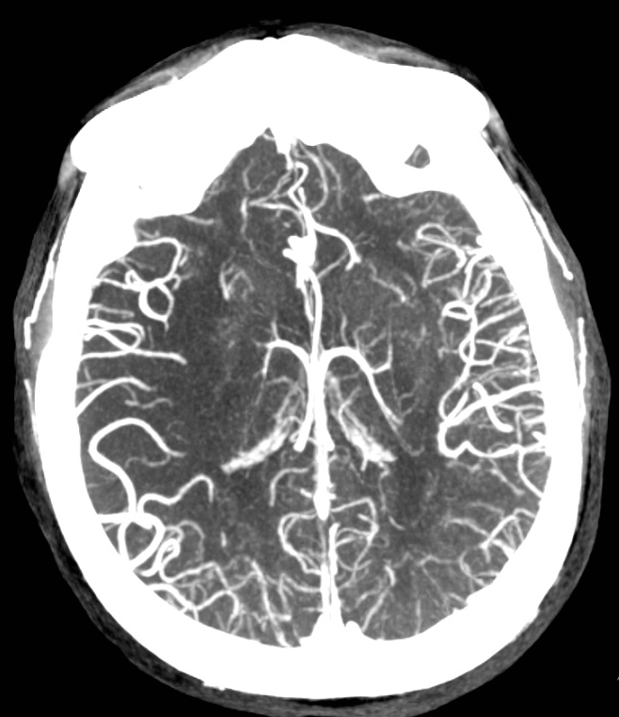
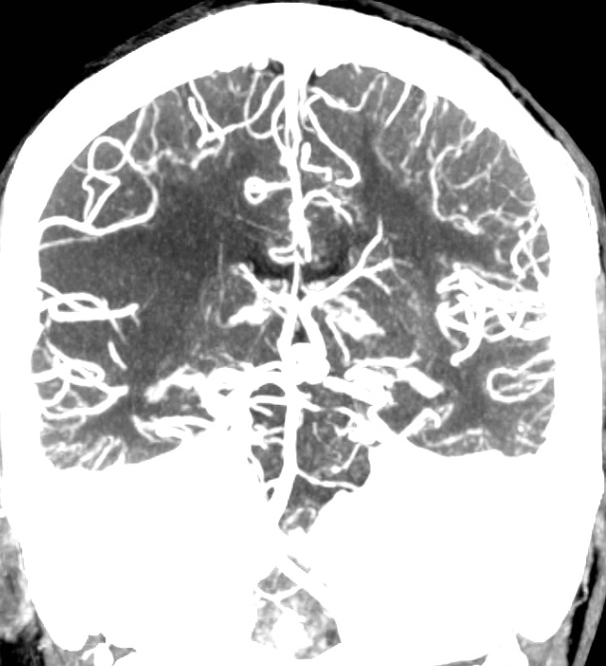
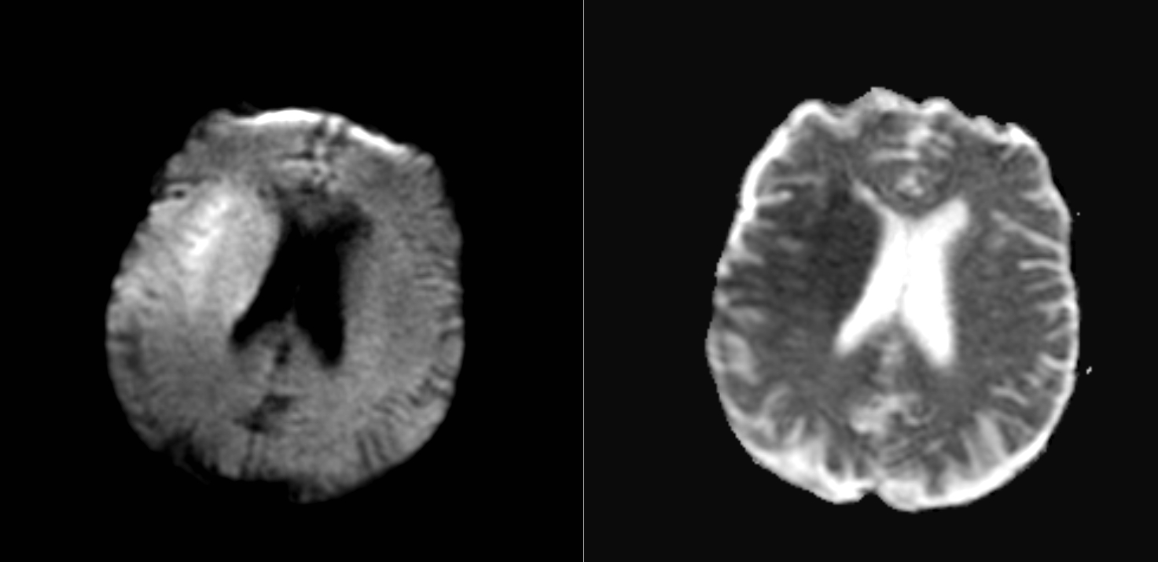
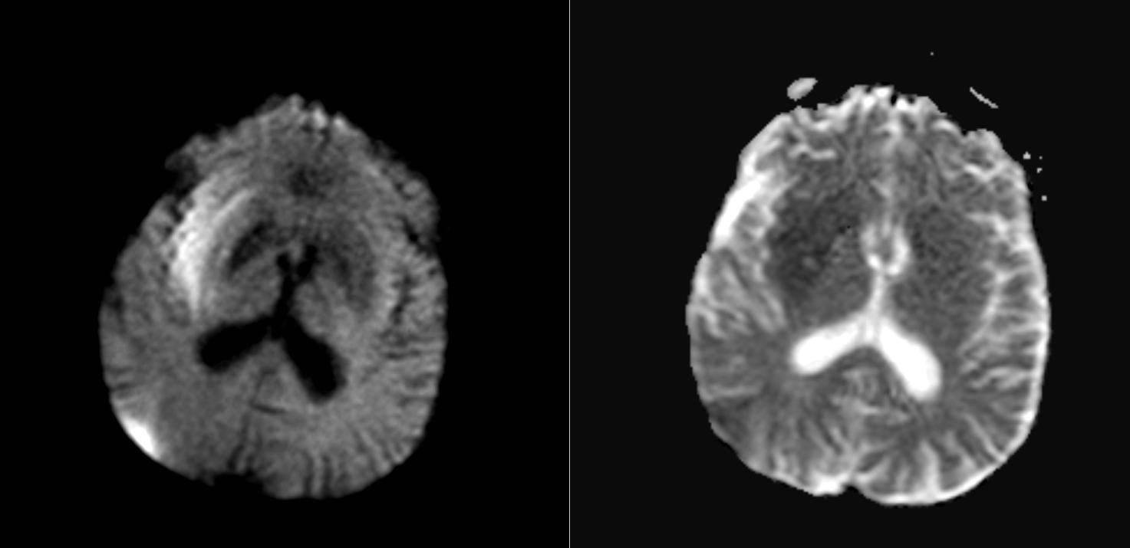
Methods: Non-malignant pattern - DWI volume of 74 ml
CTA hypo-enhancement volume
(L x W x H)/2 = 5.5 x 5 x 5/2 = 69ml
DWI volume 74ml

Slide 10
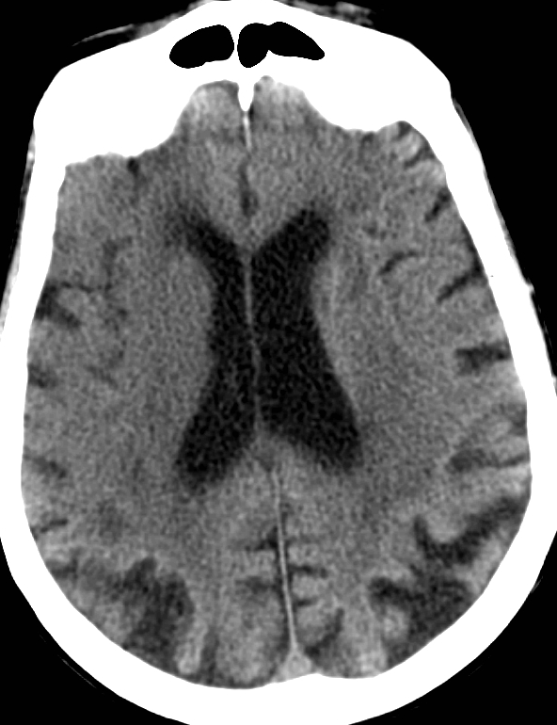
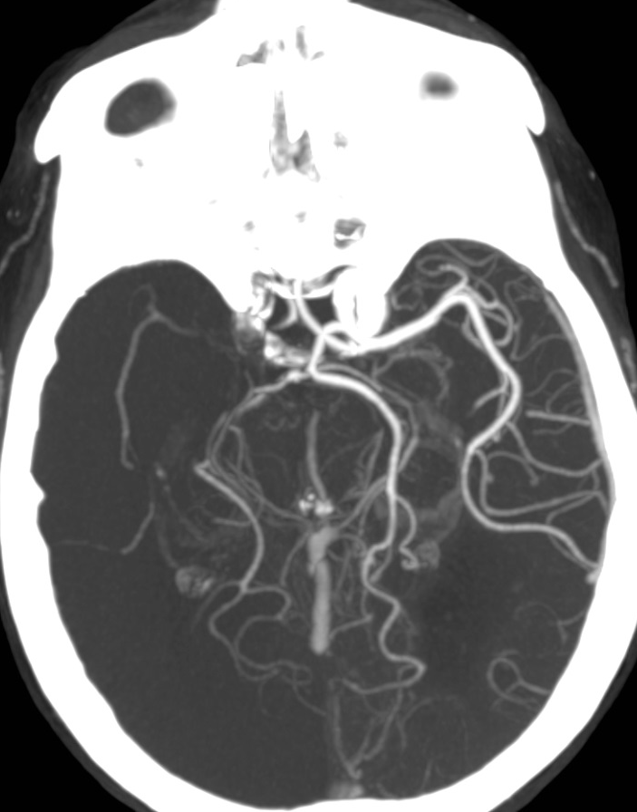
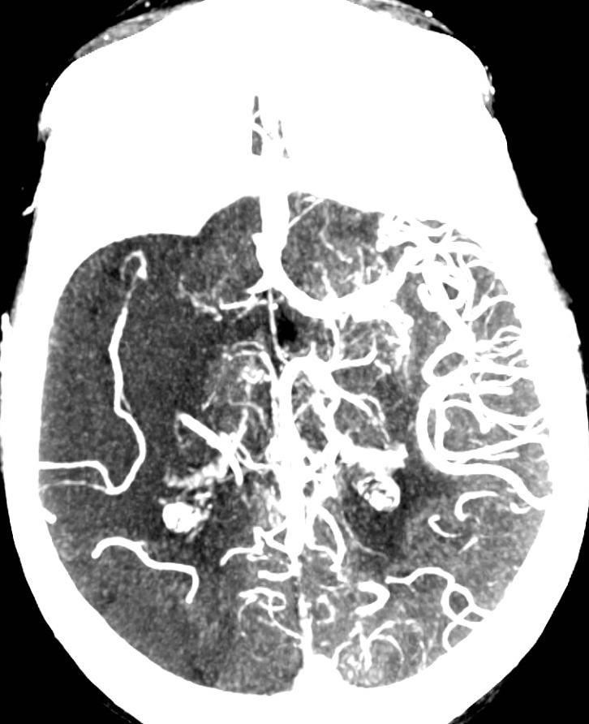
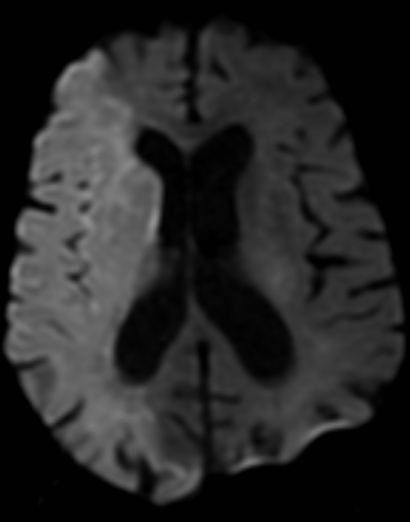
Methods: Malignant pattern - DWI volume of 275ml

Slide 11
Results
 | Utilization of Resources | Avoid Under-Treatment
 | “Don’t Transfer” (>100 ml) | “Transfer” (<100 ml)
 | Sensitivity | Specificity
CTP A | 0.42 | 1.00
CTP B | 0.67 | 0.98
ED Rad Fellow | 0.75 | 0.98
Consensus CAQ NR | 0.83 | 0.98
NIR Fellow | 0.92 | 1.00
Strong inter-observer agreement between the “Consensus CAQ NR” scores with Cohen’s Kappa: 0.89

Slide 12
Conclusion
For the purpose of making transfer decisions from “spoke” to “hub” centers for IAT treatment – if DWI is unavailable for accurate “core” assessment - a simple and easy to implement standardized CT/CTA protocol may be sufficient, without added sensitivity or specificity provided by CTP
Additional prospective studies with more patients are required for validation of our results

Slide 13
Thank You

