Slide 1
Hospital and EMS Collaboration through an EMS Quality Group
Josh Onyan, BSN, RN, SCRN
Stroke Program Manager
Upstate Comprehensive Stroke Center
Syracuse, NY
NECC October 25, 2018
Notes:
Introduction to myself, program and region that we support
Discuss that this is a relatively simple idea that was easy to execute, sustainable and extremely effective
Follow along on our journey of the idea and creation of an EMS Quality Group

Slide 2
Disclosure
No relevant financial relationships exist

Slide 3
A question for you.
ARS Q1: Q- Regarding EMS pre-notification on in-bound presumptive stroke patients, I would consider my emergency department:
Answer:
Traditional: we receive a phone call from EMS with a basic report
Modern: it’s 2018 so there’s an app for that
Uber-modern: pertinent information is abstracted from a digital EMS chart and displayed on a status board in real-time in our ED
We like to wing it: we get no pre-notification, anything goes, say a prayer before each ED shift
Notes:
As a precursor for the rest of my presentation, please answer the following question for me…

Slide 4
What we know and where we were…
With advanced notification, a presumptive stroke patient can receive a more rapid emergency department (ED) triage, expedited diagnostic imaging and has a higher chance of receiving IV thrombolysis¹.
The percent of pre-notification of stroke patients by EMS in 2015 at Upstate University Hospital (aka Upstate) was around 46% as reviewed in an internal database.
Stroke team prior to arrival 1%
Treatment times inconsistent and essentially unpredictable

Slide 5
How and who can help to improve this?
Establish a formal quality improvement group with the purpose of providing a collaborative open forum between hospital stroke programs and pre-hospital EMS providers.
Central and Northern New York REMAC and EMS Agency Directors
EMS quality officers/educators
Members from the Upstate Stroke Team
Identify actual/potential barriers that exist at both prehospital ad hospital level
There was an identified knowledge gap with EMS related to advanced notification requirements and other pre-hospital stroke care
Develop educational strategies and dissemination plan
Provide specific feedback related to EMS pre-notification and case outcomes

Slide 6
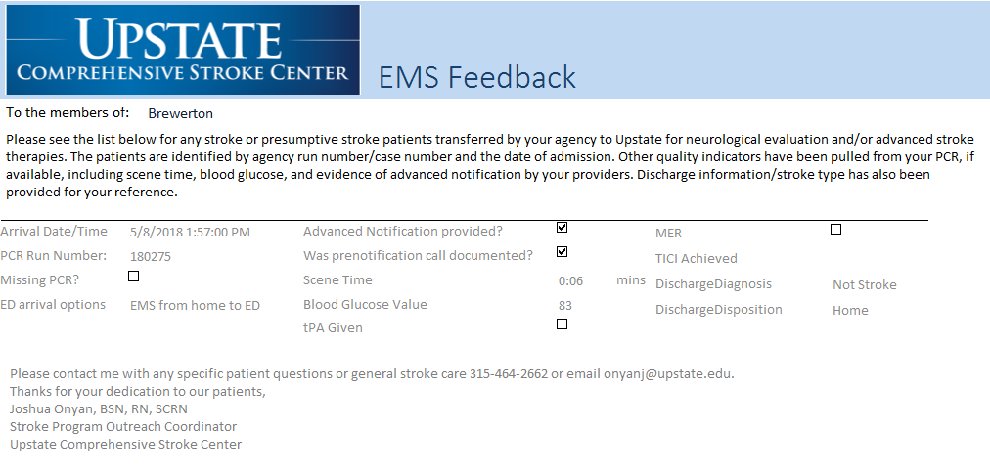
Educational Materials and Feedback

Slide 7
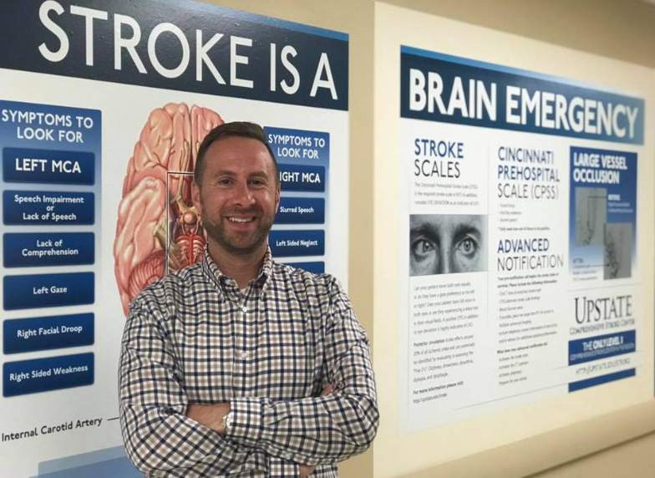
Educational Materials and Feedback

Slide 8
Data collection and presentation
The Stroke Team at Upstate was responsible for reviewing all PCR’s and stroke codes during 2016, 2017, and 2018
Data was entered into an independent hospital-kept database
A monthly dashboard was maintained and presented to the EMS Quality Group for review and comparison

Slide 9
But did it work?
Retrospective data was analyzed to include only patients with a final stroke diagnosis (acute ischemic stroke, transient ischemic attack, intracerebral hemorrhage, subarachnoid hemorrhage) that arrived to Upstate via EMS within 6 hours of last know well
2016: 170 patients that meeting this arrival criteria, 137 of which had evidence of advanced notification (80.5% yearly average)
2017: 204 patients meeting this arrival criteria, 178 of which had evidence of advanced notification (87% yearly average)
2018 (January 1- June 30): 102 patients meeting this arrival criteria, 94 had evidence of advanced notification (92% yearly average)

Slide 10
Eureka! It works…
46 % Baseline

Slide 11
Conclusions and implications for practice
Education, feedback and collaboration allows for positive and constructive interactions, discussion and education between hospital stroke programs and EMS members that continuously enhance patient care
Despite efforts to increase awareness of the importance of advanced notification, barriers still remain:
CPSS non-conclusive: what does this really mean to EMS?
LKW unknown: should EMS call for this?
resolving symptoms: why call if the symptoms have gone away?
atypical stroke-like symptoms: not all strokes are created equal?

Slide 12
Special thanks, contact Information, and references
Special thanks:
Jennifer Schleier, BSN, RN, SCRN, CCRN
Michelle Vallelunga, MS, RN, SCRN, CCRN
Bill McGarrity, EMT-P
Tracie Desantis EMT-P
Doug Sandbrook, EMT-P
Susie Surprenant, EMT-P
Ann Smith, EMT-B
Jim Hogan, EMT-P
Josh Onyan, BSN, RN, SCRN
Stroke Program Manager
onyanj@upstate.edu
www.upstate.edu/stroke
1. McKinney, J. S., Mylavarapu, K., Lane, J., Roberts, V., Ohman-Strickland, P., & Merlin, M. A. (2013). Hospital prenotification of stroke patients by emergency medical services improves stroke time targets. Journal of Stroke and Cerebrovascular Diseases, 22(2), 113-118.

